Slide 1
These slides contain animations, when the PowerPoint file is played
The content gradually appears with clicks
Questions appear before their answers

Slide 2
Green Chemistry and Living in the Desert
Water
Staying alive – drinking
Clean water for drinking, what are the problems?
How is water sterilized, chlorine, UV, ozone
How is water purified? Distillation, reverse osmosis, deionization, charcoal.
Drink containers - Recycling
Cooling off – Swimming pool chemistry
Chlorine, pH, buffers, water hardness
Cleaning – detergents, dishwashing, laundry
Biodegradation, algal blooms, eutrophication

Slide 3
Cooling Off – Swimming Pools
Going for a swim is a great way to cool off!
Keeping a swimming pool both safe and aesthetically pleasing requires careful maintenance of the water
Chemistry plays a critical role in doing this
What are some problems that a pool can have?

Slide 4
Cooling Off – Swimming Pools
What are some problems that a pool can have?
Remedy
Poor Appearance?
Dirt, leaves, insect bodies, other solids
Scale buildup
Green water
Corrosion of metal parts
Strong smell
Filtration
Decrease dissolved salts
Chlorination
Balance pH
Chlorination
Safety/Effects on people?
Transmit disease
Burn eyes
Bleach hair/clothes
Turn hair green
Too cold/hot
Chlorination
Balance pH
Chlorination
Chelating agent
Let’s look at some of these in more detail

Slide 5
Swimming Pool Chemistry
Maintaining pool chemistry involves using chemicals to control the following:
Chlorination
pH
Buffer level
Stabilizer level
Dissolved salts/Water hardness
Some chemicals may need to be added less frequently:
Algaecide
Water clarifier/flocculant
Copper remover
Phosphate remover

Slide 6
Swimming Pool Chemistry - Chlorination
What does chlorine do?
Chlorine is a disinfectant
The aim is to kill any organisms in the pool and to inactivate viruses
A relatively low level of chlorine in the water is quite effective at killing bacteria, parasites, fungi, algae, and destroying viruses without causing much problem for human swimmers
Other less commonly used disinfection methods include:
Bromine
Ozone
UV light
Hydrogen peroxide/UV light

Slide 7
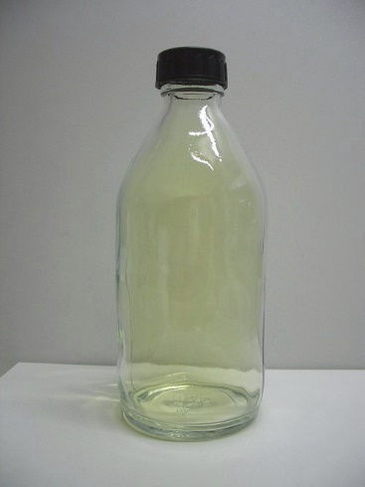
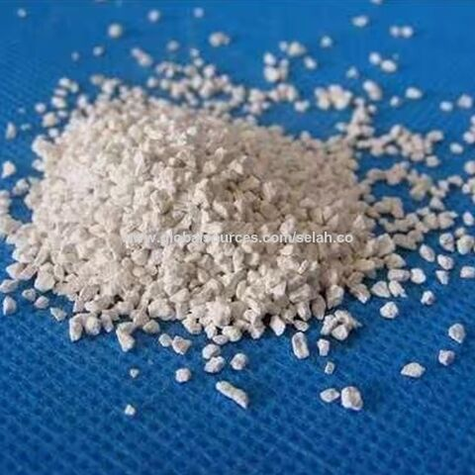
Swimming Pool Chemistry - Chlorination
Chlorine (Cl₂)
While chloride (Cl⁻) is necessary for all know species of life, chlorine (Cl₂) is poisonous to most living organisms
Chlorine is a yellow-green gas! bp -34 °C
So how are all these things “chlorine”?:
Wikipedia - chlorine
https://images.app.goo.gl/euFU3TK4k8XqtMrL6
https://images.app.goo.gl/g5nie2hbBK6CseaE6

Slide 8
Swimming Pool Chemistry - Chlorination
Chlorine reacts with water to form hypochlorous acid:
Cl₂(g) + H₂O ⇄ HOCl + H⁺ + Cl⁻
Hypochlorous acid is in equilibrium with its dissociated form:
HOCl ⇄ + H⁺ + OCl⁻
Which species are present in water is highly dependent on pH
At pH 7.5 (typical pool pH) and 25 °C, the amounts of hypochlorous acid (HOCl) and hypochlorite ion (⁻OCl) are about equal
In strongly acidic water (low pH [~2]) chlorine is mostly present as dissolved Cl₂
In basic water (pH > 8) chlorine is mostly present as hypochlorite ion (⁻OCl)

Slide 9
Swimming Pool Chemistry - Chlorination
HOCl + ⁻OCl
Cl₂
⁻OCl
pH
At pH 7.5 (typical pool pH) and 25 °C, the amounts of hypochlorous acid (HOCl) and hypochlorite ion (⁻OCl) are about equal
In strongly acidic water (low pH [~2]) chlorine is mostly present as dissolved Cl₂
In basic water (pH > 8) chlorine is mostly present as hypochlorite ion (⁻OCl)
The sanitizing effect is better when there is more HOCl/Cl₂ present
However, Cl₂ will escape at some rate from the system

Slide 10
Swimming Pool Chemistry - Chlorination
So, what are these?:
This “Chlorine” is solid calcium hypochlorite (Ca(OCl)₂)
Reaction with acid in the pool will generate HOCl, which is in equilibrium with Cl₂
This “Chlorine” is an aqueous solution of sodium hypochlorite (NaOCl)
Unlike calcium hypochlorite, it is not stable in solid form and is always used as a solution

Slide 11
Swimming Pool Chemistry - Chlorination
These tablets are made from trichloroisocyanuric acid
These react with acid to form chlorine (Cl₂)
The same reaction occurs to release all three chlorines

Slide 12
Swimming Pool Chemistry - Stabilizer
The reverse reaction of chlorine release can also occur to add Cl to isocyanuric acid
Cyanuric acid is added to the pool as a “stabilizer”, it reversibly binds some of the free chlorine, effectively giving a slower release, so giving a slower loss of chlorine

Slide 13
Swimming Pool Chemistry - pH
HOCl + ⁻OCl
Cl₂
⁻OCl
pH
Hypochlorite ion (⁻OCl) is not as effective at sanitizing as hypochlorous acid/chlorine
This means the water should not be too basic (high pH) as it will lower the sanitizing power of the chlorine
However, when there is more Cl₂ present in the water, it can leave the water as a gas and be lost
So, there is a balance between having a decent amount of “free” chlorine present and it being lost as a gas from the water, this is controlled by the pH

Slide 14
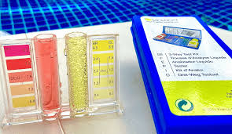
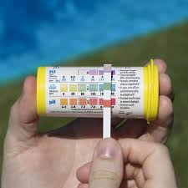
Swimming Pool Chemistry - pH
HOCl + ⁻OCl
Cl₂
⁻OCl
pH
But the water can’t just be any pH, the swimmers will not tolerate the water if it is too basic or too acidic
When eye irritation occurs in a swimming pool the most likely cause is low pH (acidic). Human tears have pH ~7.0-7.4. That is a good target for the pool.
Low pH (acidic) also speeds corrosion of metal parts in the pool
https://images.app.goo.gl/9wa2qBCKq54bMmbZA

Slide 15
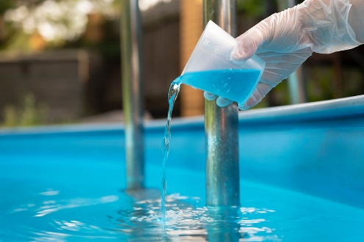
Swimming Pool Chemistry - pH
How is pH adjusted?
Lower the pH – make it more acidic
Most commonly - add concentrated hydrochloric acid! Aka “muriatic acid”
Isn’t that dangerous?
Yes! Contact with skin will cause immediate burns, contact with eyes will cause catastrophic damage
Additionally, the fumes coming from concentrated HCl are noxious and corrosive
Safer solid acid sources such as NaHSO₄ are also available, however they are generally much more expensive

Slide 16
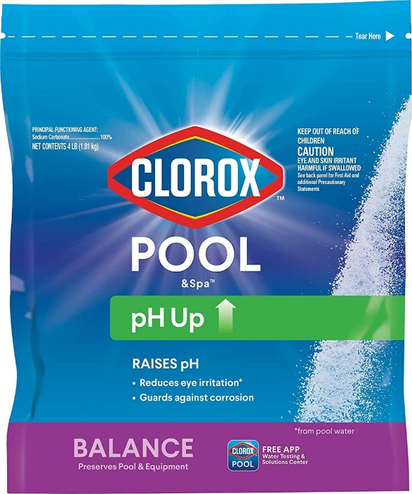
Swimming Pool Chemistry - pH
How is pH adjusted?
Increase the pH – make it more basic
Most commonly - add solid Na₂CO₃
Could add e.g. NaOH, but Na₂CO₃ is sufficiently basic and more easily handled, safer, and stable for storage

Slide 17
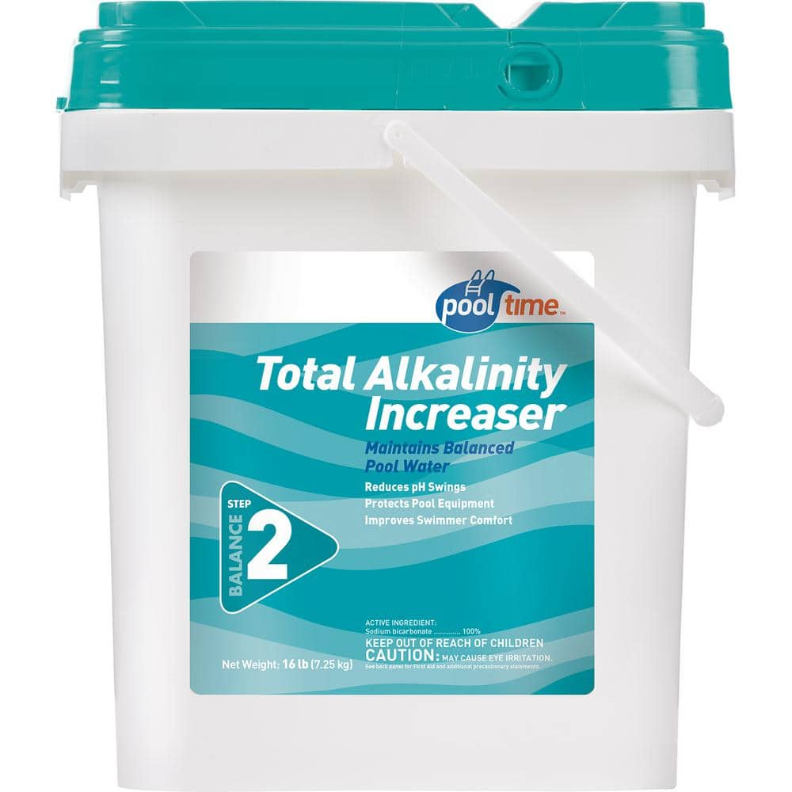
Swimming Pool Chemistry - Buffer
A buffer is typically used with the pool water
Aka “total alkalinity” increaser
This is usually solid sodium bicarbonate (NaHCO₃)
What is a buffer? Why is it used?
Adding a small amount of acid or base to the pool can cause a large swing in pH. Similarly, the pH can vary widely when the acid concentration changes for other reasons
A buffer helps to maintain a near constant pH, even when sizable amounts of acid or base are added:
⁻OH
H⁺
CO₃²⁻ ← HCO₃⁻ → H₂CO₃

