Slide 1
These slides contain animations, when the PowerPoint file is played
The content gradually appears with clicks
Questions appear before their answers

Slide 2
Carbon Dioxide – It’s not all bad
Carbon dioxide results from the combustion of carbon containing fuels (= most of the ones we use)
As a consequence, we have certainly heard about carbon dioxide (CO₂) as the main culprit for the greenhouse effect and global warming
It is a problem because we are emitting truly massive amounts of it into the atmosphere from combustion (37 billion tons in 2023)
However, it is a very useful substance with many attractive properties
It is effectively non-toxic
It is chemically stable
It has useful melting/boiling/critical points
https://www.climate.gov/news-features/understanding-climate/climate-change-atmospheric-carbon-dioxide#:~:text=Since%20the%20middle%20of%20the,the%20Global%20Carbon%20Budget%202023.

Slide 3
Carbon Dioxide – It’s not all bad
As a gas that is part of our normal physiological functioning, it is not particularly toxic. The air we breath out contains about 5% CO₂!
Composition of air during breathing
 | Inhaled | Exhaled
N₂ | 78% | 78%
O₂ | 21% | ~16%
Ar | 1% | 1%
CO₂ | 0.04% | ~5%
H₂O | varies | saturated
What else changes between inhaled and exhaled air?

Slide 4
Carbon Dioxide – It’s not all bad
CO₂ is a very useful substance with many attractive properties
Name some familiar uses of CO₂:
Drink carbonation
Fire extinguishing
Refrigerant – dry ice
Leavening (raising) bread
CO₂ lasers
As a “green” solvent

Slide 5
Carbon Dioxide – Drink Carbonation
Sodas and other sparkling drinks get their bubbles from carbon dioxide
Why not use some other gas to make drinks bubbly?
Some reasons:
Toxicity – clearly a problem! (e.g. NH₃, SO₂, H₂S, CO, NO₂)
Odor – 4/5 of the examples above (NH₃, SO₂, H₂S, NO₂ also have unpleasant odors)
Cost – CO₂ is quite cheap and readily available
Solubility - the gases from air (N₂, O₂, Ar) meet the criteria of low toxicity, no odor, and low cost. However, they have very poor solubility in water.

Slide 6
Carbon Dioxide – Drink Carbonation
Why not use some other gas to make drinks bubbly?
Solubility – CO₂ has good solubility in water.
Henry’s Law tells us that the amount of gas that can dissolve in a liquid is proportional to the pressure of the gas above the liquid.
We see this when opening a soda bottle, the pressure over the liquid reduces and so the CO₂ solubility reduces, leading to gas coming out of solution in the form of bubbles
Also, a small amount of CO₂ reacts with water:
CO₂ + H₂O ⇄ H₂CO₃
H₂CO₃ is an acid, making the water more acidic (pH 3-4). This contributes to the flavor of carbonated drinks and water.

Slide 7
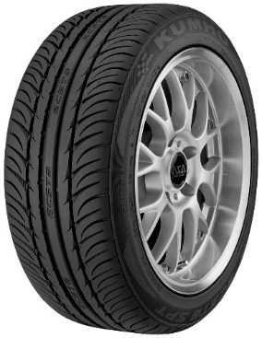
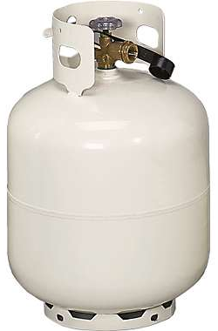
Carbon Dioxide – Drink Carbonation
How does the CO₂ get in the drinks?
Some drinks, like soda, are pressurized with CO₂ e.g. from a gas cylinder
A typical soda can or bottle is pressurized to about 30-50 psi at room temperature. That’s around 2-3 times atmospheric pressure
Soda bottle
Narrow Bike Tire
Propane tank
Nitrogen
cylinder
Car Tire
~2 atm
~3 atm
6-8 atm
10-13 atm
~145 atm
Inflating a balloon - ~ 0.1 atm

Slide 8
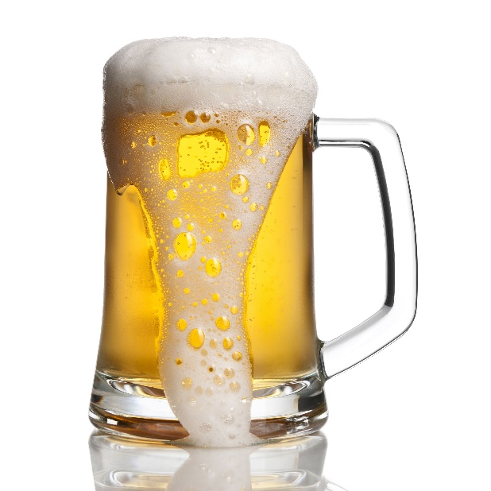
Carbon Dioxide – Drink Carbonation
How does the CO₂ get in the drinks?
Other drinks, like beer and champagne, get their CO₂ from the fermentation process that produced their alcohol:
C₆H₁₂O₆ → 2 C₂H₅OH + 2 CO₂
sugar
ethanol
https://images.app.goo.gl/WxYZdZrS7jr1okNCA
https://physicsworld.com/a/six-secrets-of-champagne/

Slide 9
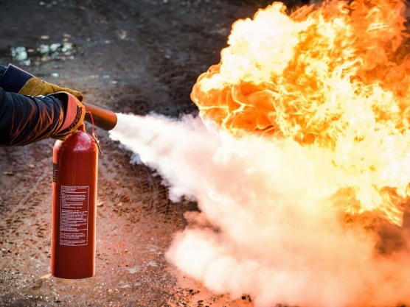
Carbon Dioxide – Fire Extinguishing
CO₂ is used in some fire extinguishers
It works by displacing air - no oxygen, no fire
https://images.app.goo.gl/oMfufQxYDnYK7SrT7
CO₂ is not flammable; it is already the product of combustion!
e.g. CH₄ + 2 O₂ → CO₂ + 2 H₂O
methane

Slide 10
Carbon Dioxide – Fire Extinguishing
CO₂ gas at atmospheric pressure is more dense than air so it tends to sink and smother a fire
Density - Air 1.29 kg per m³
CO₂ 1.98 kg per m³
It can’t absorb much heat, like water can. So, fires can reignite when the CO₂ disperses, so it is best suited to small fires.
What makes it a better choice than water for electrical fires?
https://images.app.goo.gl/oMfufQxYDnYK7SrT7

Slide 11
Carbon Dioxide – Fire Extinguishing
Some other facts about CO₂ and fire extinguishing:
CO₂ is not flammable, but it can serve as an oxygen source for some very reactive substances, like reactive metals. It can’t be used on that type of fire because it can make the fire worse!
e.g. 2 Mg + CO₂ → 2 MgO + C (+ heat)
A CO₂ fire extinguisher is at sufficient pressure to liquefy the CO₂ inside (59 atmospheres at room temp).
Interestingly, some older fire extinguishers worked by mixing acid with sodium bicarbonate. That reaction releases CO₂, but its major function in that case was to pressurize the container to squirt the liquid (mostly water) out at the fire
e.g. ⁻HCO₃(aq) + H⁺ (aq) → H₂CO₃
H₂CO₃ ⇄ CO₂ (g) + H₂O

Slide 12
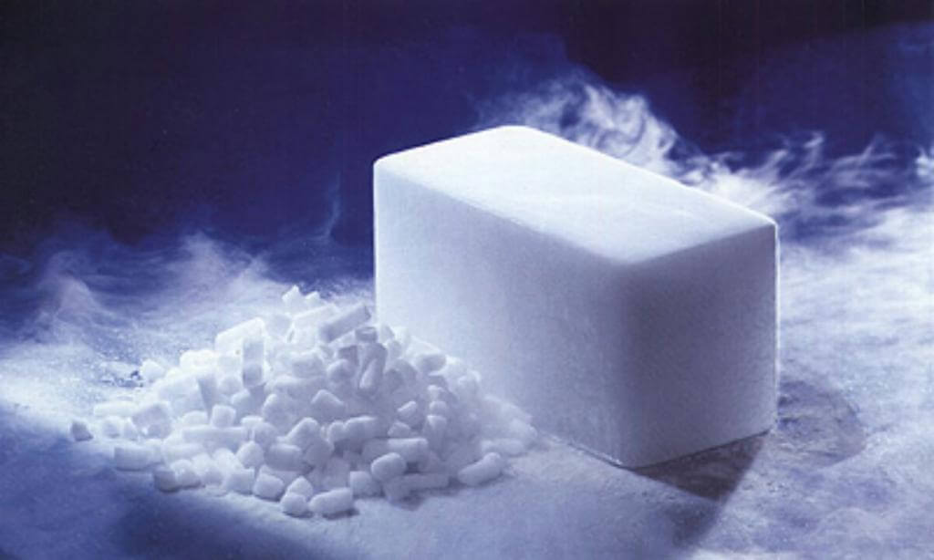
Carbon Dioxide – Dry Ice
https://images.app.goo.gl/eqQy3Cd2k2bb6K619

Slide 13
Carbon Dioxide – Dry Ice
CO₂ does not exist as a liquid at atmospheric pressure
Instead, if cooled sufficiently (-78 °C) it changes directly from a gas to a solid “dry ice”
Dry ice is useful as a cooling agent
What are some advantages of dry ice vs water ice?
It can cool things to a much lower temperature than water ice
Water ice melts leaving a liquid that has to be dealt with
As dry ice sublimes (equivalent term to “evaporates” when talking about the solid → gas phase change) the gas diffuses away, leaving no residue to deal with

Slide 14
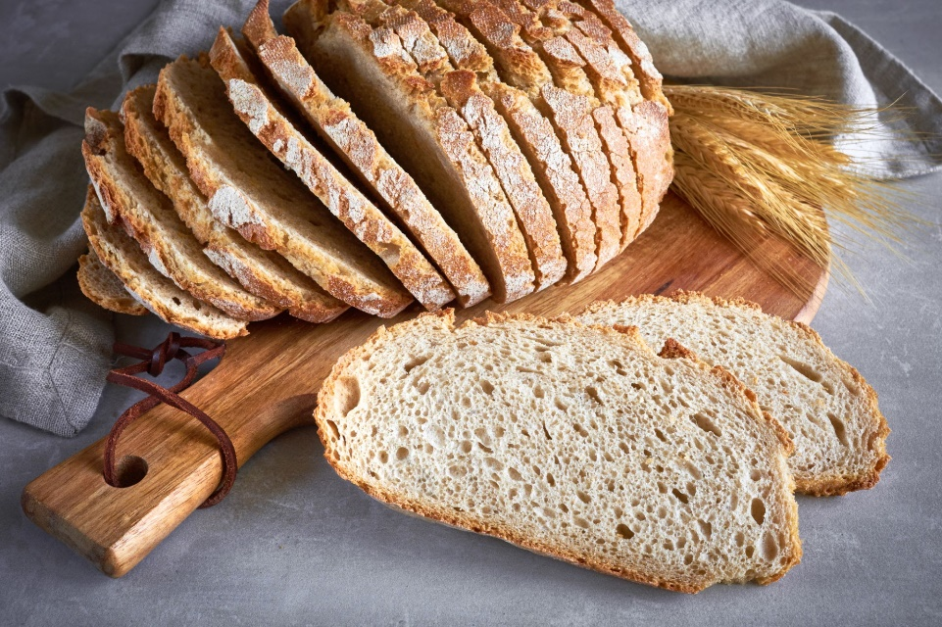
Carbon Dioxide – Leavening
Leavening adds volume to baked goods (bread, cake, etc.)
Bubbles of gas (usually CO₂) expand within the dough or mix, “raising” it
When the mixture sets, the trapped bubbles are responsible for the sponge-like structure that we see in bread and cake.
https://t1.gstatic.com/licensed-image?q=tbn:ANd9GcQwu9l5QEVRGPd9-hQ90jhpiGAMg1ycT46XWkXivXoCYaZ2RUm0Fz_Y0ZVxsJ50o3_K

Slide 15
Carbon Dioxide – Leavening
There are two common ways that the CO₂ gas is produced:
1. “Biological” – Baker’s yeast
The fermentation reaction produces CO₂ and ethanol. The process is usually slower than with the chemical leavening agents
C₆H₁₂O₆ → 2 C₂H₅OH + 2 CO₂
sugar
ethanol
2. “Chemical” – Bicarbonate + acid
Baking powders contain a bicarbonate salt (e.g. NaHCO₃) an acid salt (e.g. potassium acid tartrate (cream of tartar) KC₄H₅O₆), and starch powder (to keep the salts from getting wet and from contacting each other). When the mixture gets wet the following reactions occur:
e.g. ⁻HCO₃(aq) + H⁺ (aq) → H₂CO₃
H₂CO₃ ⇄ CO₂ + H₂O

Slide 16
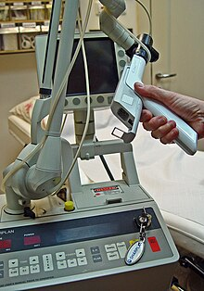
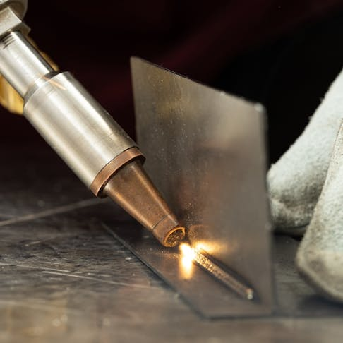
Carbon Dioxide – Lasers
The carbon dioxide laser is one of the most useful laser types
They are used in industrial and medical applications
https://images.app.goo.gl/T3d4dWF2ikLdxpTa6
https://en.wikipedia.org/wiki/Carbon-dioxide_laser

Slide 17
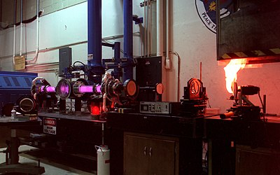
Carbon Dioxide – Lasers
It is a gas laser where CO₂ is the radiative emitter
It is easy to produce high power levels at reasonable cost
They are used for industrial cutting and welding
They are also used for medical applications, such as in laser surgery to cut, ablate, vaporize, and coagulate
The emitted laser light is infrared, it is invisible!
https://en.wikipedia.org/wiki/Carbon-dioxide_laser

Slide 18
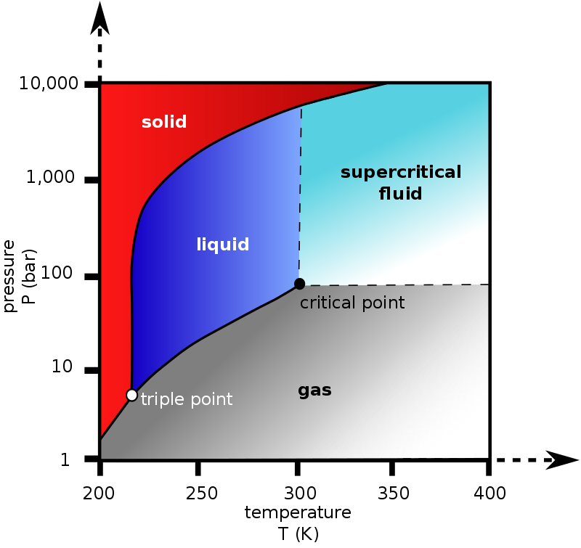
Carbon Dioxide – A Green Solvent
We know that CO₂ is a gas and that dry ice has the unusual property of subliming (phase changing directly from a solid to a gas) at normal pressure
But CO₂ can certainly exist in liquid form and also finds use when in a supercritical state
From this image –
What is the lowest pressure required for CO₂ to exist as a liquid?
What pressure is required for CO₂ to be a liquid at room temperature?
https://en.wikipedia.org/wiki/Carbon_dioxide

Slide 19
Carbon Dioxide – A Green Solvent
Supercritical – What does that mean?
Above the critical point temperature, a substance cannot be liquified, at any pressure.
Supercritical fluids display properties of both liquids and gases.
Fills the volume of its container, like a gas
Can more effectively dissolve other substances, like a liquid
https://en.wikipedia.org/wiki/Carbon_dioxide

Slide 20
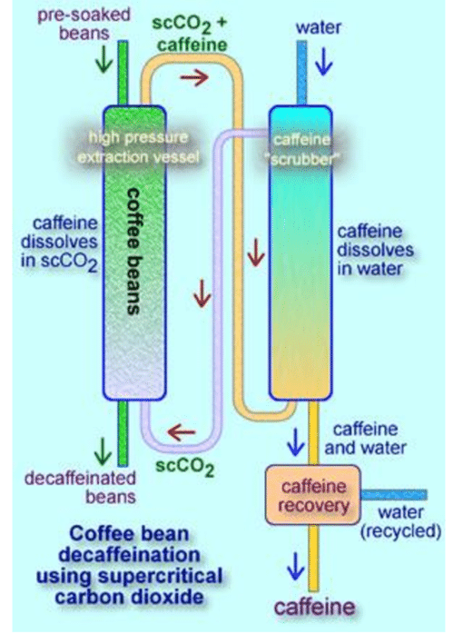
Carbon Dioxide – A Green Solvent
Supercritical CO₂ is used as a solvent
A substance that is dissolved can be recovered by releasing the pressure, all the CO₂ will evaporate away!
For example, supercritical CO₂ can be used to extract caffeine from coffee
This is a greener process than using the major alternative, methylene chloride (CH₂Cl₂), which is toxic and an ozone depleting substance
https://images.app.goo.gl/gYZkSdwh96Um75X39

Slide 21
Carbon Dioxide – A Green Solvent
Another example involves using supercritical CO₂ for “dry cleaning”
This is also a greener alternative to the standard solvent, perchloroethylene
https://images.app.goo.gl/6jTmj8smmpxgzTxT7

Slide 22
Carbon Dioxide – A Green Solvent
How can using CO₂ as a solvent be green?
Most importantly, it is safe and effectively non-toxic
The reasoning is simple,
CO₂ is obtained from the environment
If it is then, released back into the environment, there is no overall change to the amount in the environment
This is very different to burning fossil fuels, which releases CO₂ into the air that was not there before

