Slide 1
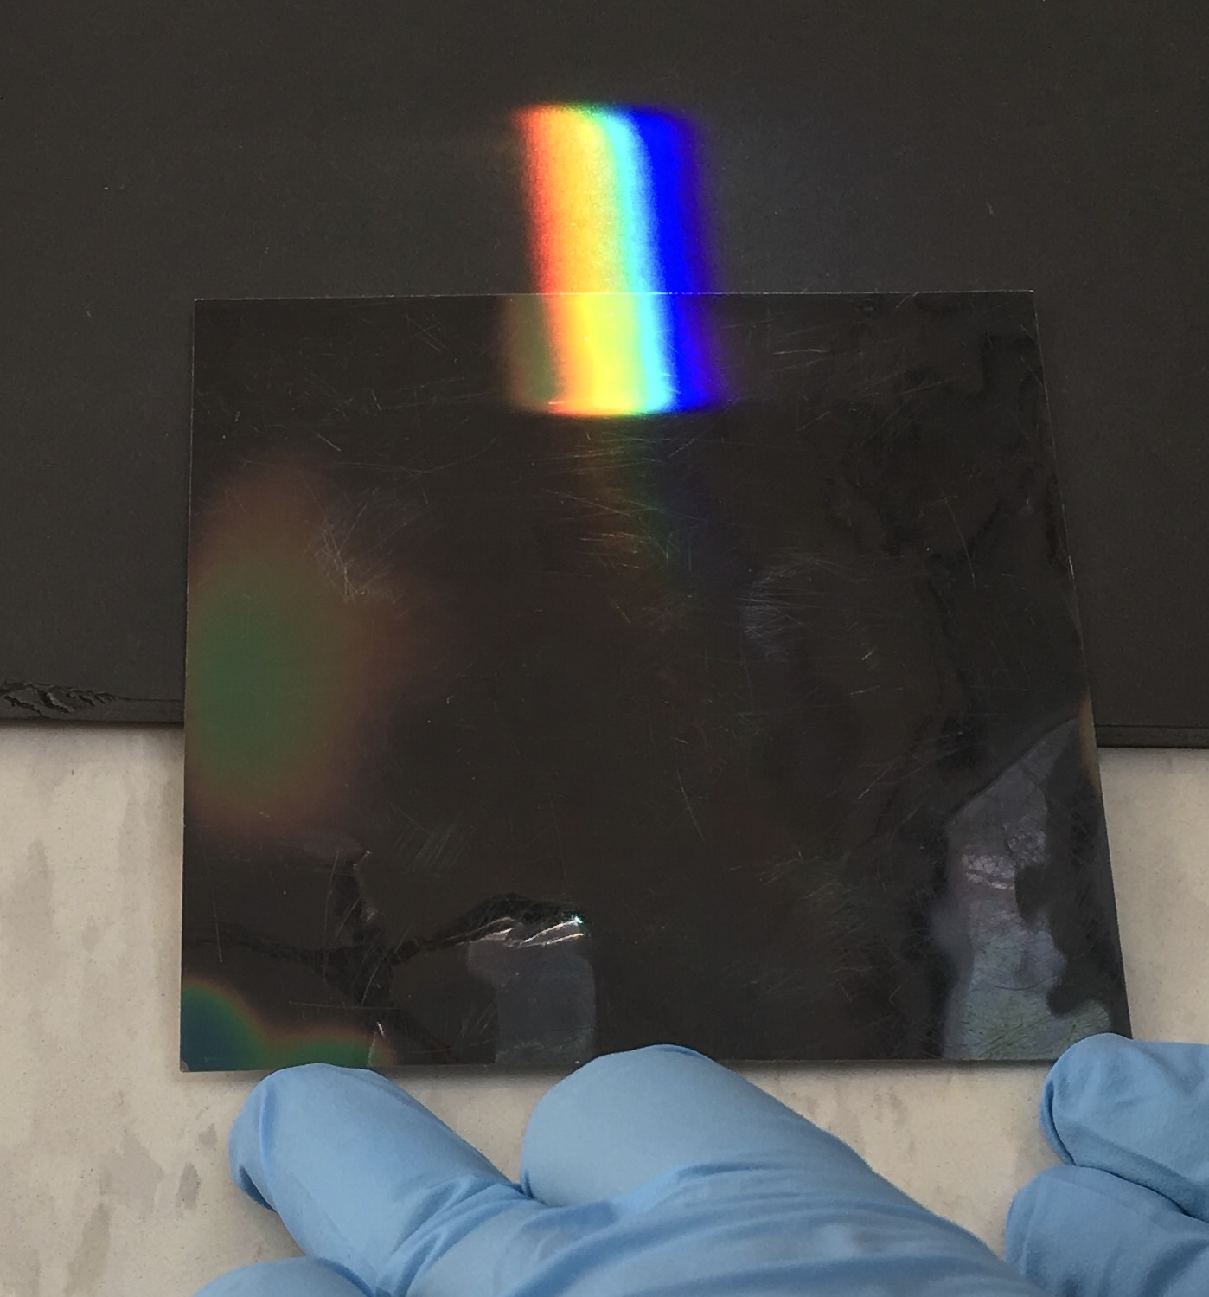
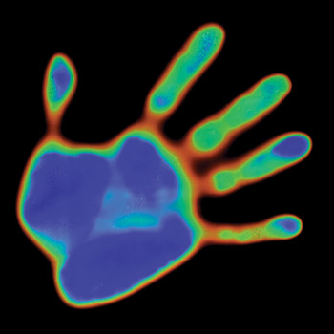
Lab Experiment – UV and IR from the Sun
Infrared
Use a prism and a heat sensitive liquid crystal card to demonstrate that there is IR light in sunlight:
Set up the prism to split the sunlight into a “rainbow”
Devise a way to use the LCD card to detect the IR radiation (absorbed IR leads to heating)
https://www.teachersource.com/product/liquid-crystal-sample-assortment

Slide 2
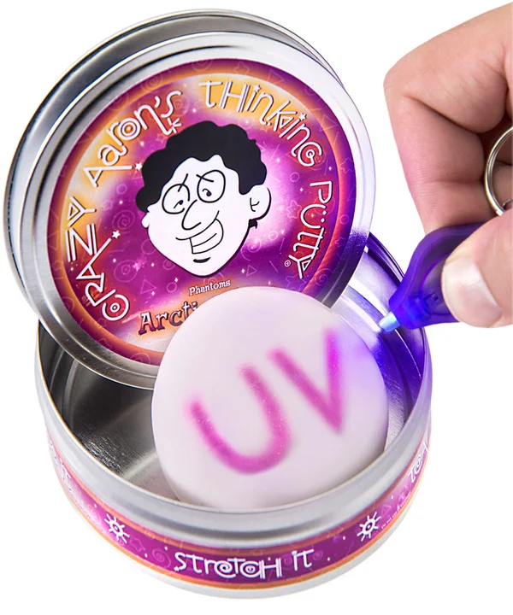
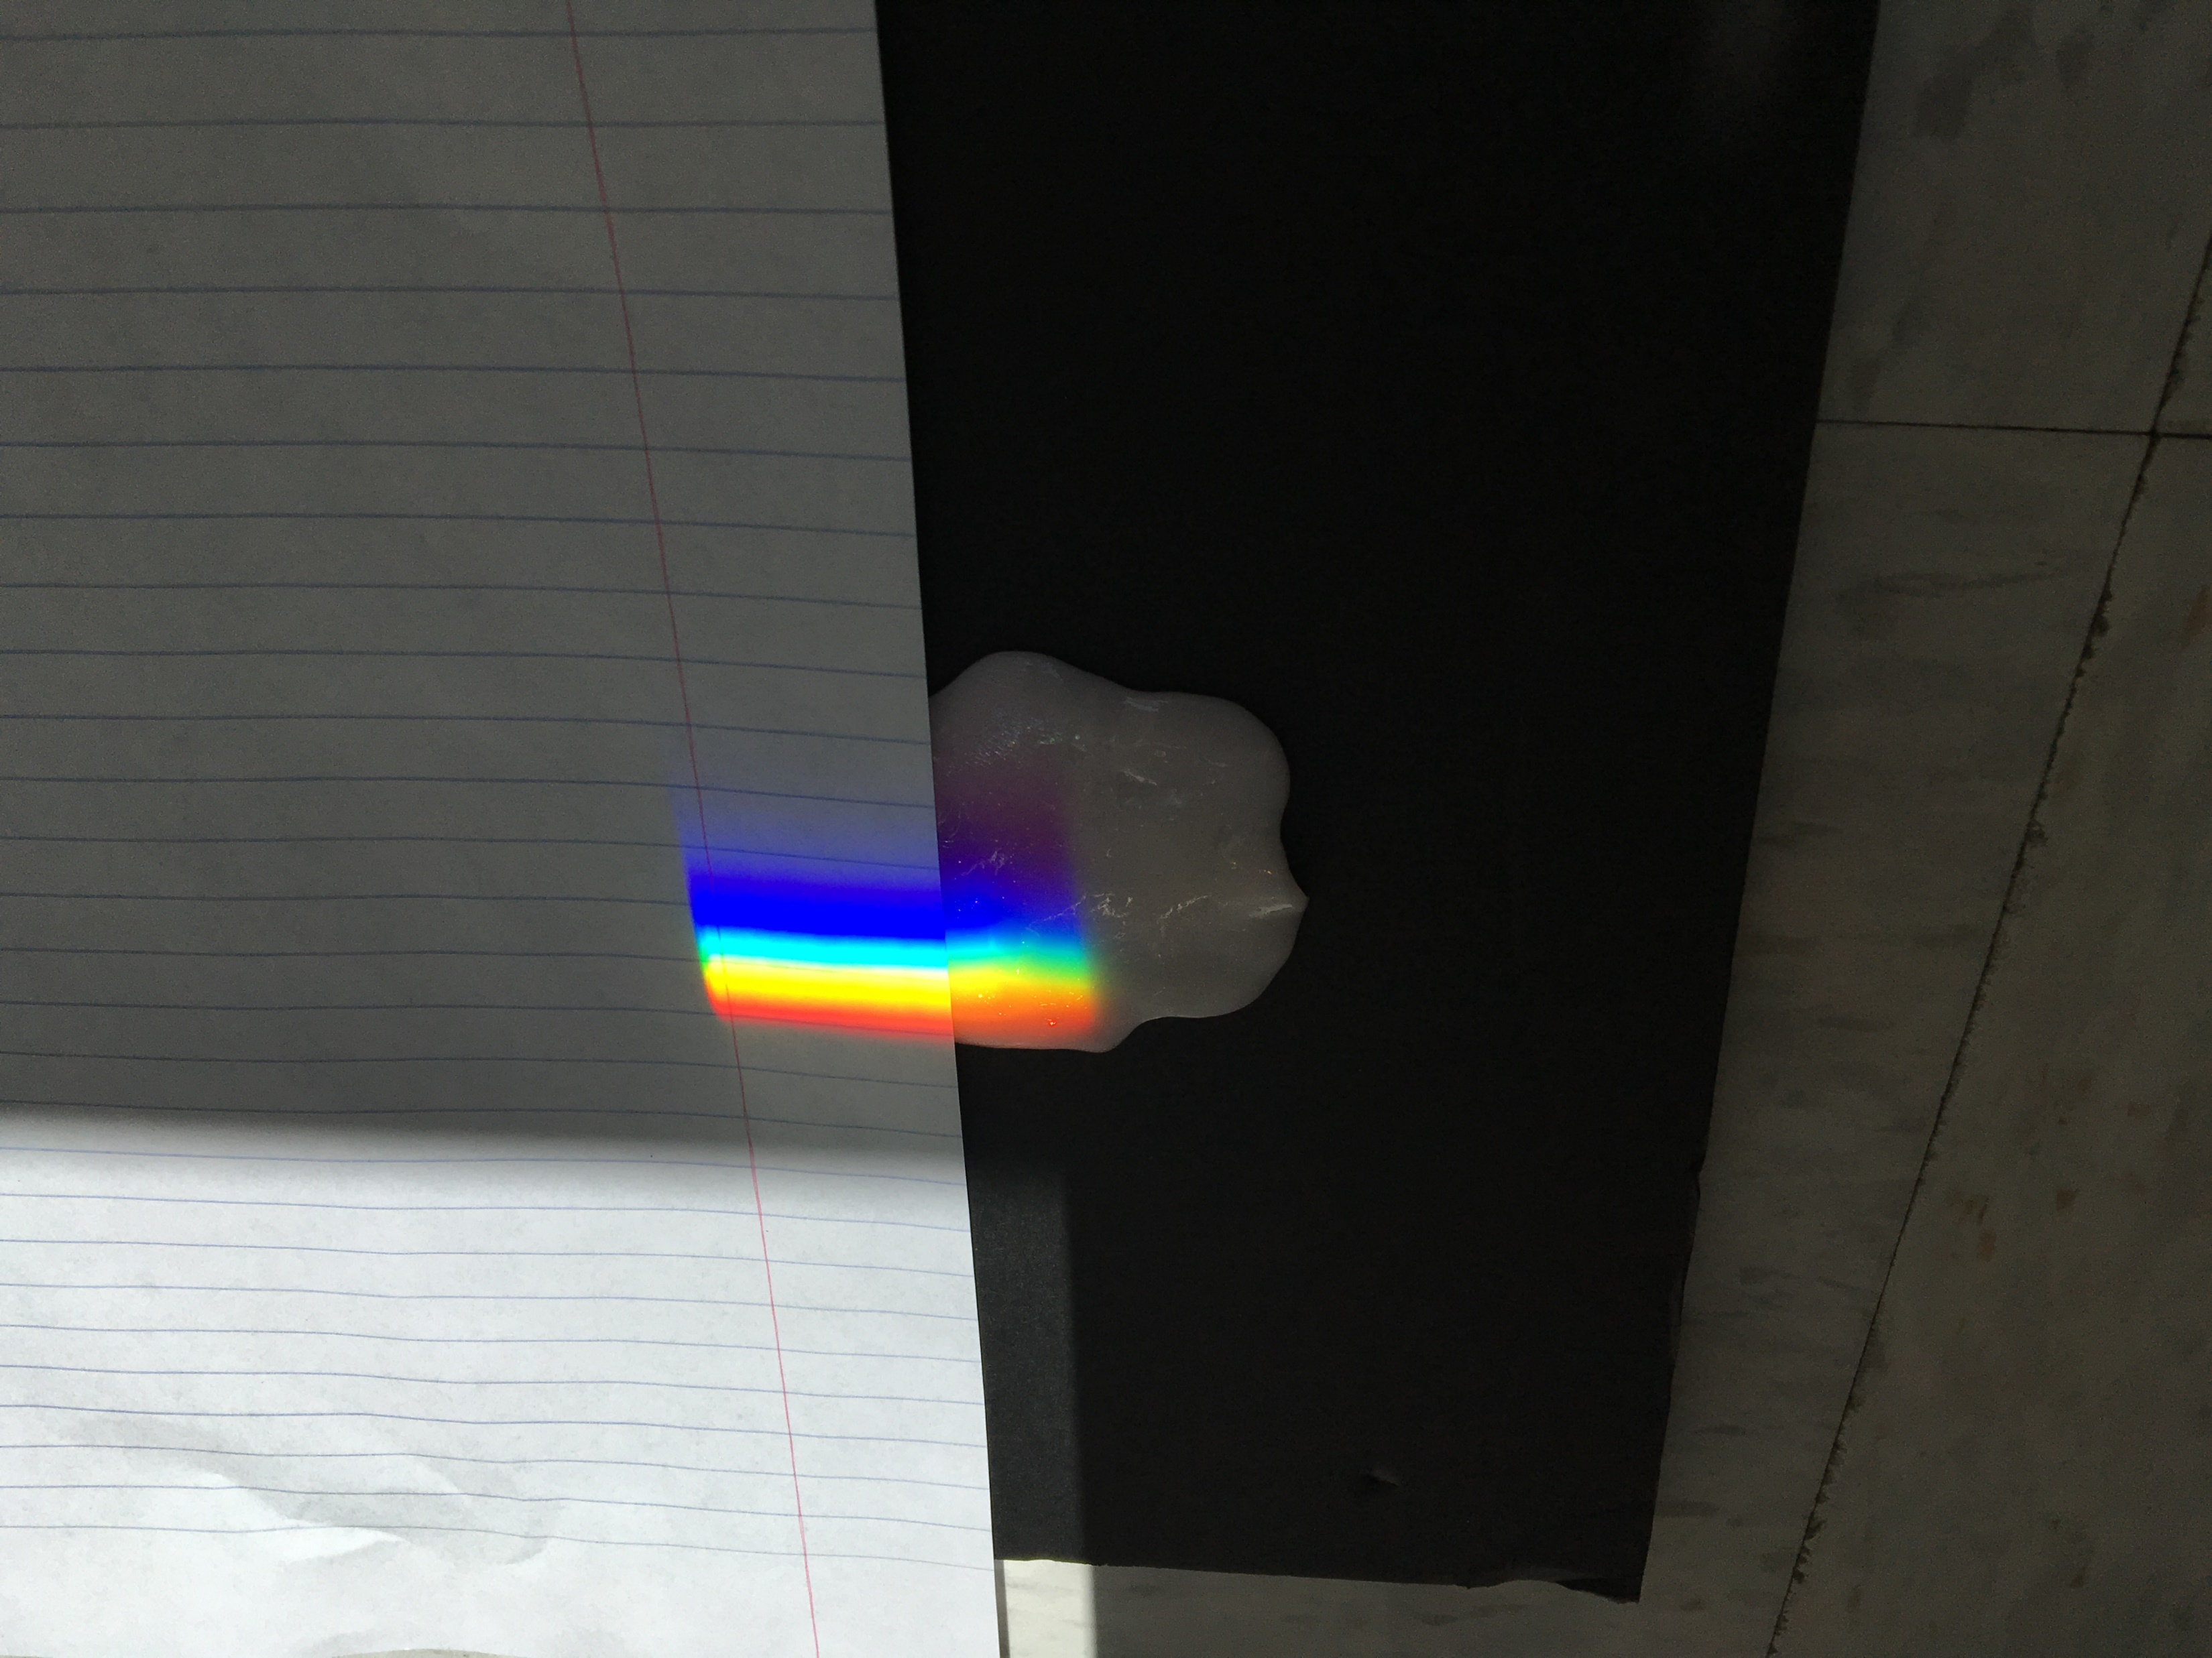
Lab Experiment – UV and IR from the Sun
Ultraviolet
Use a prism and UV reactive putty to demonstrate that there is UV light in sunlight
Set up the prism to split the sunlight into a “rainbow”
Devise a way to use the putty to detect the UV radiation
https://www.vat19.com/item/uv-phantom-thinking-putty

