Slide 1
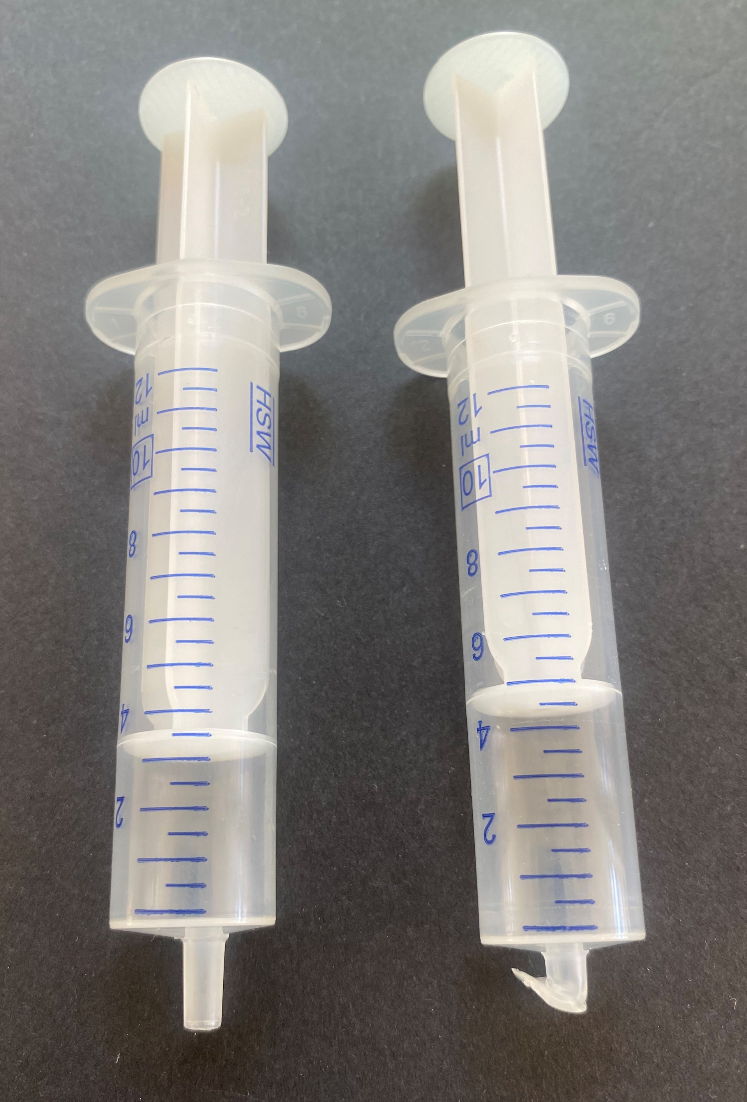
Lab Experiment – Liquifying a Gas
Use a plastic syringe to compress a gas (butane) until it liquifies (state of matter vs pressure, heat of vaporization, refrigeration principles)
Prepare the Hardware:
Use a disposable polypropylene syringe (an all-polypropylene plunger is preferred over one that has a rubber part).
Briefly heat the Luer tip of the syringe with a flame (don’t burn it)
While hot, press the tip against a flat surface (fold the tip over) and let it cool
If done correctly, that will seal the end
Sealed

Slide 2
Lab Experiment – Liquifying a Gas
Fill with Butane:
Use butane from a canister typically used to refill small butane torches
Turn the canister upside down, point it into the syringe body and open the valve (press it in) – use pliers to do this (cold burns can occur from touching the liquid butane)
Liquid butane will come out of the nozzle, and some will collect in the syringe (as the liquid evaporates the gas produced will displace the air in the syringe)
Insert the plunger at just the moment when the last bit of liquid evaporates
Ready!

Slide 3
Lab Experiment – Liquifying a Gas
Do the Experiment:
Push the syringe barrel in, at some point liquid will be seen to condense
Allow the liquid to cool, then let the plunger go out
The liquid will boil
Touch the syringe after the compression and after the decompression to feel the temperature changes

