Slide 1
These slides contain animations, when the PowerPoint file is played
The content gradually appears with clicks
Questions appear before their answers

Slide 2
Chemistry and Living in the Desert
Sun
What we do and don’t want from it
Energy from the sun (fossil fuels vs renewables)
Light/matter interactions
Infrared, heat, greenhouse effect
Ultraviolet, sunburn, sunscreen, oxygen, ozone layer

Slide 3
Energy from the Sun
Many things that we do require energy!
We use electricity to power many machines and processes
Like what?
Lighting, TV, devices, heating, cooling, power tools, cooking, cleaning (vacuum, dishwasher, clothes washer)
What is the other (not electricity) major method that we use to power things? Give examples.
Burning fuels! Cooking, heating. Big one – transportation.

Slide 4
Energy from the Sun
Burning fuels vs using electricity
For some types of transportation, fuel burning engines are apparently the only way to go
Examples?
Cars? – Not anymore! The last 10 years or so has seen the widespread adoption and use of electric cars
Aircraft – We are yet to see practical human-carrying electric aircraft

Slide 5
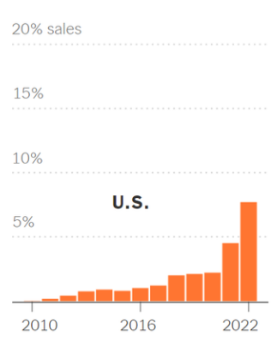
Energy from the Sun
Electric Cars - electric models as percentage of total passenger vehicle sales
New York Times 10-19-2023

Slide 6
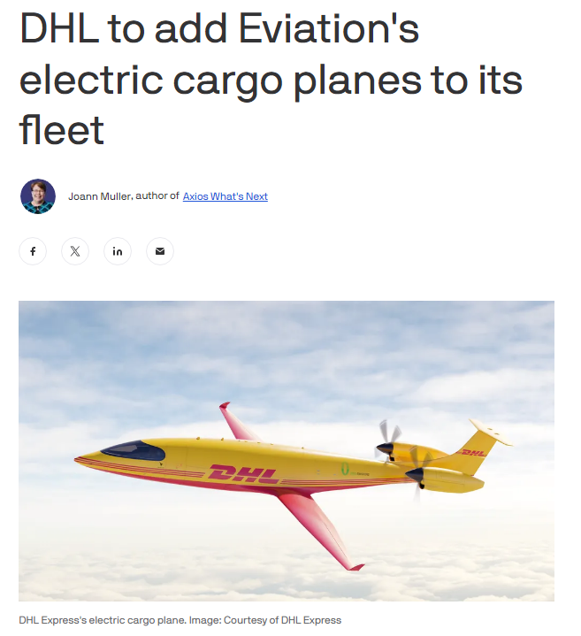
Energy from the Sun
Electric Airplanes? - they are certainly being investigated

Slide 7
Energy from the Sun
Transport
Why do we need to use fuel burning engines rather than electricity for making an airplane fly?
It is all about the energy that can be stored for a given mass
We can have quite powerful electric devices in the home, which is fine when you can have effectively unlimited energy by plugging it into a wall socket
But there is presently no competition between the amount of energy that can be carried by a given mass of gasoline or aviation fuel vs batteries (much, much less)! This extra energy is absolutely necessary in some cases, like for airplanes.​

Slide 8
Energy Content
In mega joules (M/J) per kilogram
Hydrogen 142
Methane 55
Lead acid battery?
0.17
Gasoline 46
Lithium ion battery?
0.4-0.9
Diesel 48
Ethanol 26
Wood 16
Importantly, a large fraction of the mass of the chemical reactants (O₂ from the air) doesn’t have to be carried by fuel-burning vehicles
Uranium 80,620,000
Antimatter-matter annihilation 89,876,000,000
https://en.wikipedia.org/wiki/Energy_density

Slide 9
Energy from the Sun
So, our energy needs are met by using electricity or burning fuels
Hang on – Where does the electricity come from?
Mostly from burning fuels!:

Slide 10
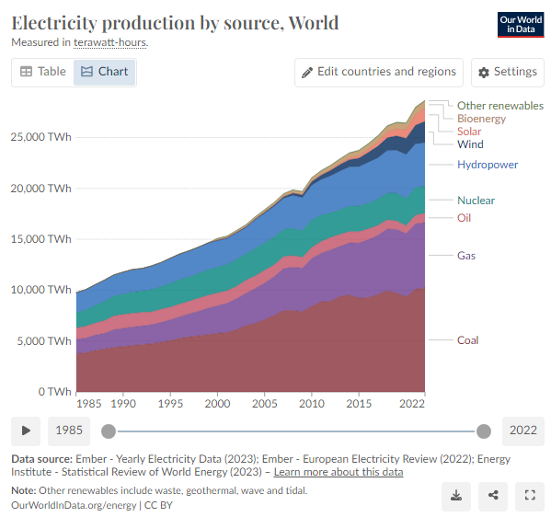
Energy from the Sun

Slide 11
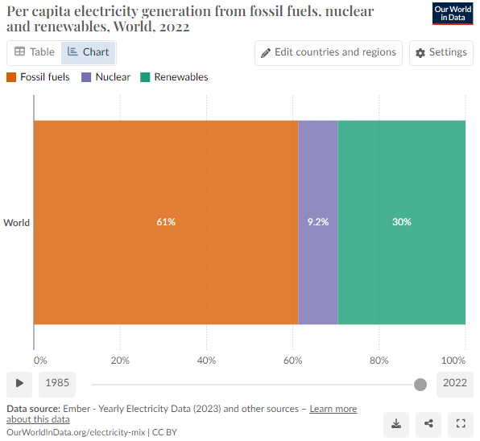
Energy from the Sun

Slide 12
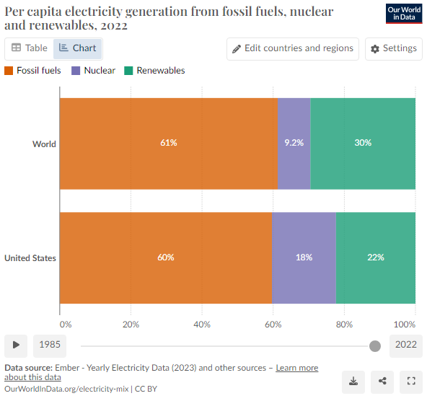
Energy from the Sun
What are those?

Slide 13
Energy from the Sun
Fossil Fuels
What are those?
Oil
Natural Gas
Coal
Why are they called fossil fuels? Where did they come from?
“Fossil” because they were formed hundreds of millions of years ago

Slide 14
Oil
aka Petroleum
Primarily hydrocarbons
Formed from zooplankton and algae
The material collected underwater in a low oxygen environment, protected from aerobic biodegradation and oxidation
Buried, compressed and heated over time to form oil
impermeable cap rock
Porous, permeable rock
Oil

Slide 15
Natural Gas
Primarily methane
Small amounts of other low molecular weight hydrocarbons
Sometimes small percentages of
carbon dioxide, nitrogen, hydrogen sulfide, and helium
Clean burning (compared to coal)

Slide 16
Natural Gas
Fossil Fuels -
Solid – Coal
Liquid – Petroleum
Gas - Natural gas
Why is it called “natural” gas?
Before the industrial scale production of natural gas, people used “town gas” = “coal gas” = “man-made gas”(?)

Slide 17
Coal Gas
This is produced by heating coal with water in a closed environment and collecting the gases that are produced.
This had various problems including the highly toxic nature of CO (carbon monoxide).
The residue from the process has uses such as asphalt.

Slide 18
Natural Gas
A cleaner burning fuel than coal
A less complex mixture than coal
Why?
Because it is a gas its composition is limited to components that are gases at room temperature and pressure
Methane (CH₄), Ethane (C₂H₆), Propane (C₃H₈)
Major component
Smaller amounts of:
Carbon dioxide (CO₂)
Nitrogen (N₂)
Hydrogen sulfide (H₂S)
Helium (He)

Slide 19
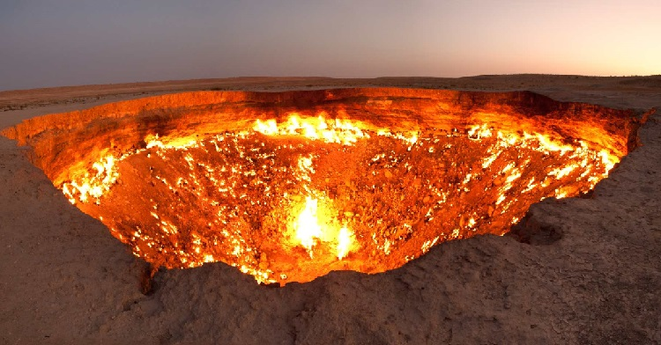
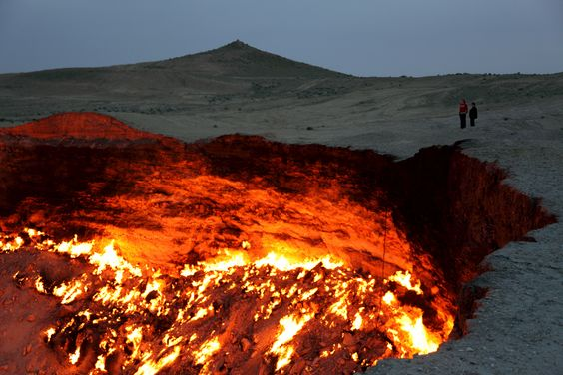
“Door to Hell” Turkmenistan – Burning (natural gas) since 1971
https://en.wikipedia.org/wiki/Darvaza_gas_crater

Slide 20
Coal
Coal
Primarily carbon
Variable amounts of hydrogen, sulfur, oxygen, and nitrogen (mostly present as compounds rather than pure elements)
Formed from trees
The forest material was buried underneath soil and protected from biodegradation and oxidation
Compressed and heated over time

Slide 21
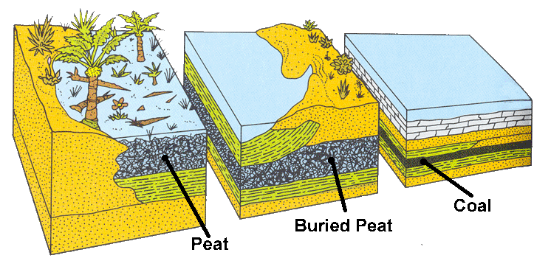
Coal
Most coal is hundreds of millions of years old

Slide 22
Energy from the Sun
Fossil Fuels
Oil
Natural Gas
Coal
They all come from plant or animal material that lived hundreds of millions of years ago.
The energy to make them came from the sun! (photosynthesis to make the plants)

Slide 23
Energy from the Sun
Bio related energy sources
Photosynthesis
All the energy stored in plant and animal material came from sunlight!
Animals eat plants – plants get the energy to grow from photosynthesis:
Light
energy
6 CO₂ + 6 H₂O -> C₆H₁₂O₆ + 6 O₂
glucose

Slide 24
Energy from the Sun
What are those?

Slide 25
Energy from the Sun
Renewable Electricity Sources
What does that mean?
Renewable
Solar
Wind
Hydroelectric
Biofuels
ethanol
biodiesel
Non-Renewable
“Fossil Fuels”
Coal
Natural Gas
Oil

Slide 26
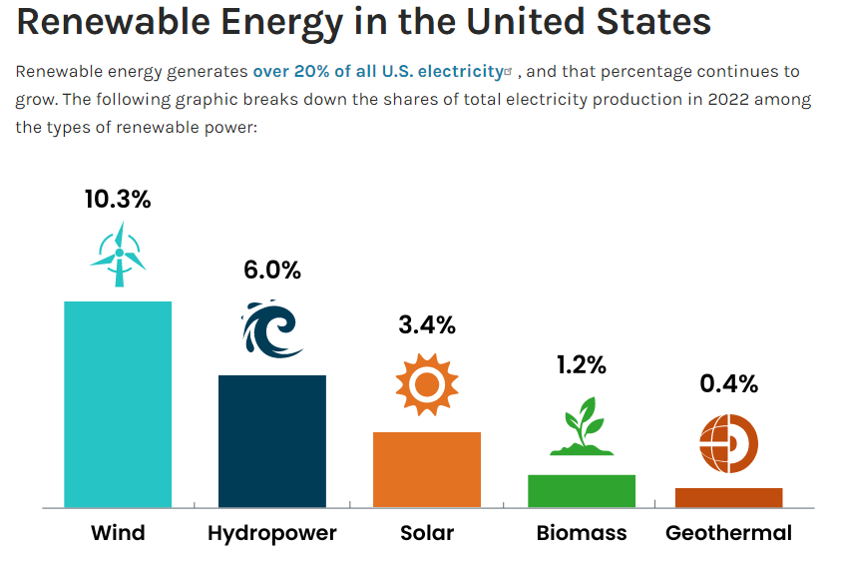
Energy from the Sun
https://www.energy.gov/eere/renewable-energy

Slide 27
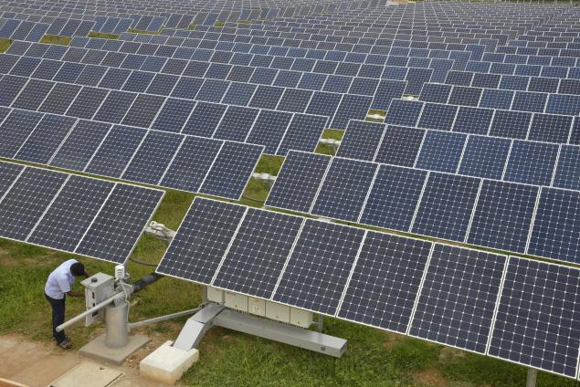
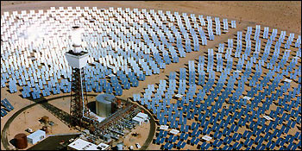
Solar Energy Generation
Direct use of energy from the sun
What is going on in this one?

Slide 28
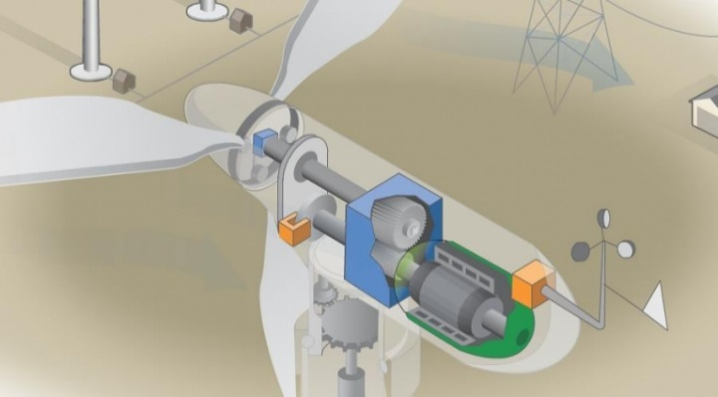
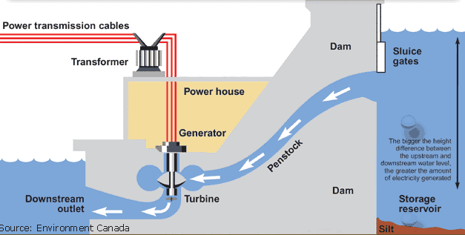
Electrical Energy Generation
Steam (from burning fuels), wind (air), or water all are used to rotate a turbine-type apparatus to spin a generator.
Wind – Comes from the sun heating the earth’s surface unevenly, leading to air movement
Water power – Water is raised to a higher gravitational potential energy by evaporating and precipitating - powered by the sun

Slide 29
Energy from the Sun
Electricity Sources
Renewable
Solar
Wind
Hydroelectric
Biofuels
ethanol
biodiesel
Non-Renewable
“Fossil Fuels”
Coal
Natural Gas
Oil
All of the energy here ultimately came from the sun!

Slide 30
Energy from the Sun
Nuclear
Only nuclear power did not come from the sun!

