Slide 1
  These slides contain animations, when the PowerPoint file is played
  The content gradually appears with clicks
  Questions appear before their answers

Slide 2
Green Chemistry and Living in the Desert
Sun
  What we do and don’t want from it
  Energy from the sun (fossil fuels vs renewables)
  Light/matter interactions
  Infrared, heat, greenhouse effect
  Ultraviolet, sunburn, sunscreen, oxygen, ozone layer

Slide 3
Green Chemistry and Living in the Desert
Sun
What do we want from the sun?
  Light to see
  Light for plants to grow
  Energy to power things
  Warmth (in winter)
  What don’t we want from it?
  Sun damage
  Sun burn
  Too much heat (summer)
  Sun in eyes while driving?
  These processes result from the different ways that sunlight interacts with matter

Slide 4
Green Chemistry and Living in the Desert
Sun
Did you know?/have you noticed:
You can sit in the sun behind a window and feel just as hot as if the window was not there, yet not get sunburned
On a somewhat cloudy day you can feel relief from the heat of the sun, yet you can still easily be sunburned
What is going on in those situations?

Slide 5
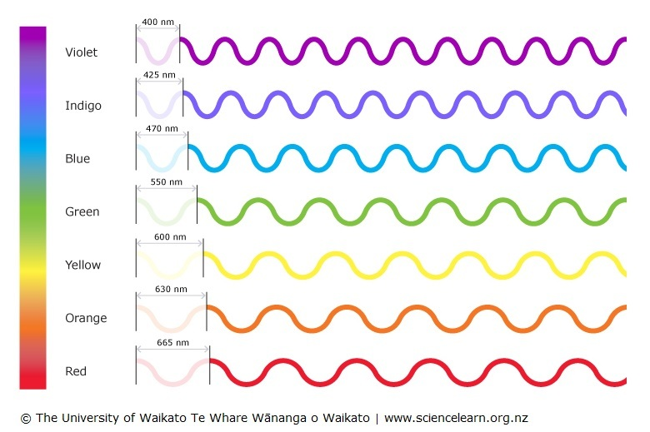
Light Matter Interactions
  Considering light as a wave, we can classify light by its wavelength:
higher
energy
But this is just what we can see!

Slide 6
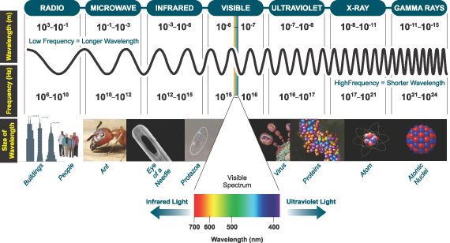
Light Matter Interactions
There is a whole range light types at both higher and lower wavelengths:
higher
energy
http://www.astro.virginia.edu/~rsl4v/PSC/light.html

Slide 7
Light Matter Interactions
What effects does each type (wavelength) of light have on molecules?:
X-rays b) Ultraviolet radiation
c) Visible light d) Infra red light
e) Microwaves f) Radiowaves
http://www.astro.virginia.edu/~rsl4v/PSC/light.html

Slide 8
Light Matter Interactions
X-rays
b) Ultraviolet radiation
Visible light
d) Infrared light
Microwaves
f) Radiowaves
Promotion of electrons from low-lying atomic orbitals
Promotion of electrons from molecular orbitals to higher energy molecular orbitals
Same as UV
Excites bond vibrations in molecules
Excites rotations in molecules
Excites nuclear spins in atoms
http://www.astro.virginia.edu/~rsl4v/PSC/light.html

Slide 9
Light Matter Interactions
Feeling hot from the sun and getting sunburned have different causes
The earlier examples highlight this:
You can sit in the sun behind a window and feel just as hot as if the window was not there, yet not get sunburned
Glass absorbs the UV radiation that causes sunburn yet allows the longer wavelengths (visible and some IR wavelengths) to pass. So, we still feel plenty hot due to the IR radiation.
On a somewhat cloudy day you can feel relief from the heat of the sun, yet you can still easily be sunburned
Clouds (water) absorb and scatter IR radiation more effectively than they do UV. So, we may feel cooler because less IR is striking us, however the penetrating UV can still easily cause sunburn.

Slide 10
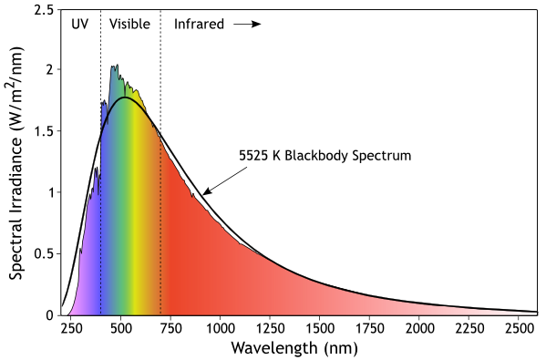
Light from the Sun
Sunlight energy reaching the earth’s surface:
3-5% Ultraviolet
42-43% Visible
52-55% Infrared
Wikipedia – “Sunlight”

Slide 11
Light Matter Interactions
X-rays
b) Ultraviolet radiation
Visible light
d) Infrared light
Microwaves
f) Radiowaves
Promotion of electrons from low-lying atomic orbitals
Promotion of electrons from molecular orbitals to higher energy molecular orbitals
Same as UV
Excites bond vibrations in molecules
Excites bond rotations in molecules
Excites nuclear spins in atoms

Slide 12


Light Matter Interactions - UV
Some important cases related to life, health, and sustainability
interaction with oxygen
interaction with ozone
vitamin D production
sunburn, DNA damage
melanin production
sunscreens

Slide 13
Light Matter Interactions - UV
http://www.astro.virginia.edu/~rsl4v/PSC/light.html

Slide 14
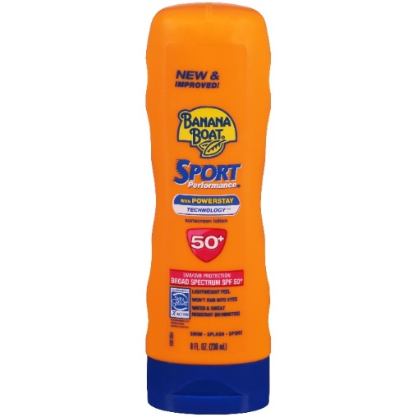
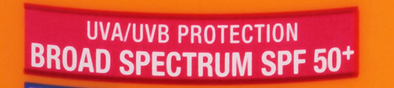
Light Matter Interactions - UV
What does this mean?

Slide 15
Light Matter Interactions - UV
UVA, UVB…What about UVC?
Which is more dangerous UVA, UVB, or UVC?

Slide 16
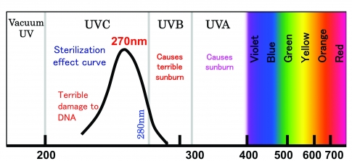
Light Matter Interactions - UV
100-280
280-315
315-400
wavelength
Which has more energy UVA, UVB, or UVC?
Shorter wavelength = higher energy (e.g. energy of UVB > UVA)
Generally higher energy -> greater damage
https://www.compoundsemiconductor.net/article/91348-building-brighter-and-cheaper-uv-leds.html

Slide 17
Light Matter Interactions - UV
b) Ultraviolet radiation
Promotion of electrons from molecular orbitals to higher energy molecular orbitals
This can lead to the breaking of covalent bonds in molecules
For example:
ultraviolet light
O=O
O + O
oxygen
molecule (O₂)
oxygen
atoms (O₂)

Slide 18
Light Matter Interactions - UV
Some important cases related to life, health, and sustainability
interaction with oxygen
interaction with ozone
vitamin D production
melanin production
sunburn, DNA damage
sunscreens

Slide 19
Light Matter Interactions - UV
ultraviolet light
O=O
O + O
Photons with wavelength 240 nm or less have sufficient energy to do this (= UVC)
100-280
280-315
315-400

Slide 20
UV light vs Oxygen
What is this compound?
What happens when ozone (O₃) absorbs UV light?

Slide 21
UV light vs Oxygen
Oxygen atoms are high-energy, reactive species
They react rapidly with O₂ to form O₃ (ozone)

Slide 22
Light Matter Interactions - UV
Some important cases related to life, health, and sustainability
interaction with oxygen
interaction with ozone
vitamin D production
sunburn, DNA damage
melanin production
sunscreens

Slide 23
Chapman Cycle
Ozone also absorbs UV light (a longer wavelength is sufficient) and can split back into O₂ and O
Those can then recombine to form O₃, the excess energy manifests as kinetic energy of the O₃ molecule (ultimately as heat)

Slide 24
O₂/O₃ Cycle
Photons with wavelength 310 nm or less have sufficient energy to be absorbed by O₃ do this (= UVB, UVC)
100-280
280-315
315-400

Slide 25
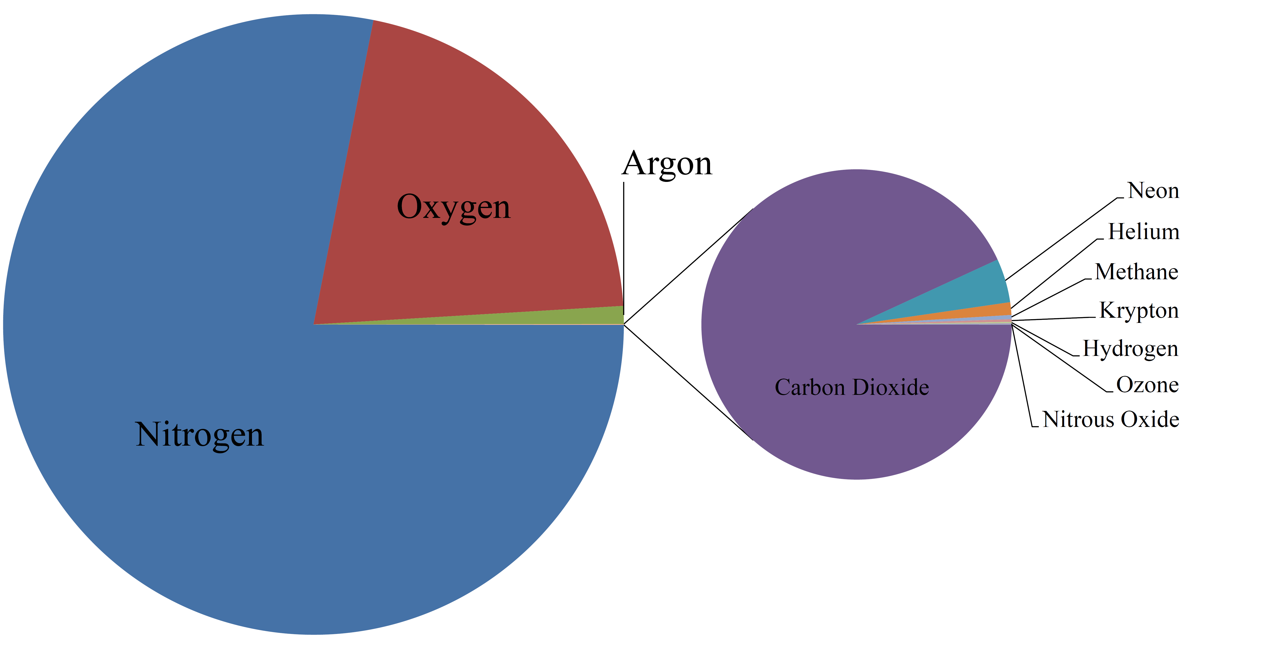
Atmosphere Composition

Slide 26
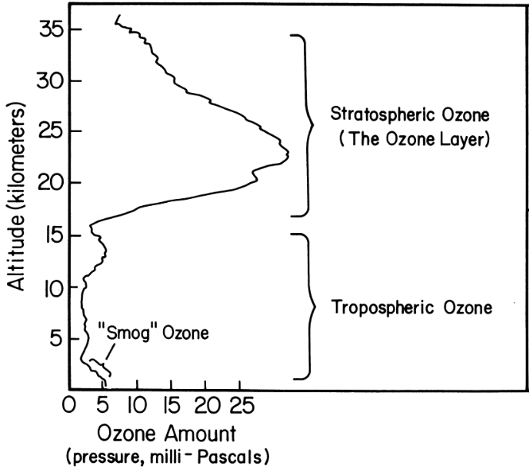
The Ozone Layer
As the second most abundant gas in the atmosphere O₂ is present in high concentration throughout
However, ozone is concentrated only at higher altitudes in the stratosphere
About 12% of the ozone layer is generated by sunlight every day
What does that mean!?
http://www.ozonelayer.noaa.gov/science/basics.htm
https://skincareclub.wordpress.com/2011/02/25/uva-uvb-uvc-rays/

Slide 27
Chapman Cycle
These reactions absorb most of the UV radiation (at those wavelengths) coming from the sun
Overall, the energy from UV light is converted into heat by these processes

Slide 28
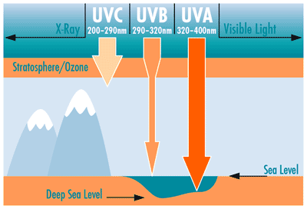
Chapman Cycle
Between the O₂ cleavage and the O₂/O₃ cycle, effectively all of the UVC and much of the UVB from the sun is absorbed by the atmosphere
https://skincareclub.wordpress.com/2011/02/25/uva-uvb-uvc-rays/

Slide 29
Light Matter Interactions - UV
Some important cases related to life, health, and sustainability
interaction with oxygen
interaction with ozone
vitamin D production
sunburn, DNA damage
melanin production
sunscreens

Slide 30
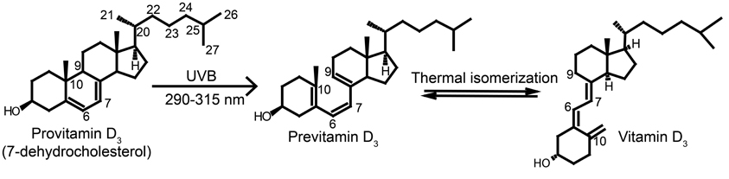
Vitamin D
“Vitamin D comes from sunlight” As a chemist what do you think about that statement?
Not the best way to express this – vitamin D is a compound, light is required to convert provitamin D into vitamin D:
1,7 H shift
(present in relatively large quantities in the skin)
https://en.wikipedia.org/wiki/Cholecalciferol

Slide 31
Vitamin D
Vitamin D₃
UV light 270-300 nm is needed for this reaction
That corresponds to UVB
What are the issues concerning getting enough vitamin D?
Sunburn/Sun Damage!
https://en.wikipedia.org/wiki/Cholecalciferol

Slide 32
Vitamin D Formation
100-280
280-315
315-400

Slide 33
Light Matter Interactions - UV
Some important cases related to life, health, and sustainability
interaction with oxygen
interaction with ozone
vitamin D production
sunburn, DNA damage
melanin production
sunscreens

Slide 34
“Sunburn”
Caused by the small amount of UVB that reaches us at ground level
UV absorption by various types of molecules can lead to formation of reactive molecules that destroy tissue
e.g.
˙OH = hydroxyl radical
There is also a specific reaction that leads directly to DNA damage
https://en.wikipedia.org/wiki/Cholecalciferol

Slide 35
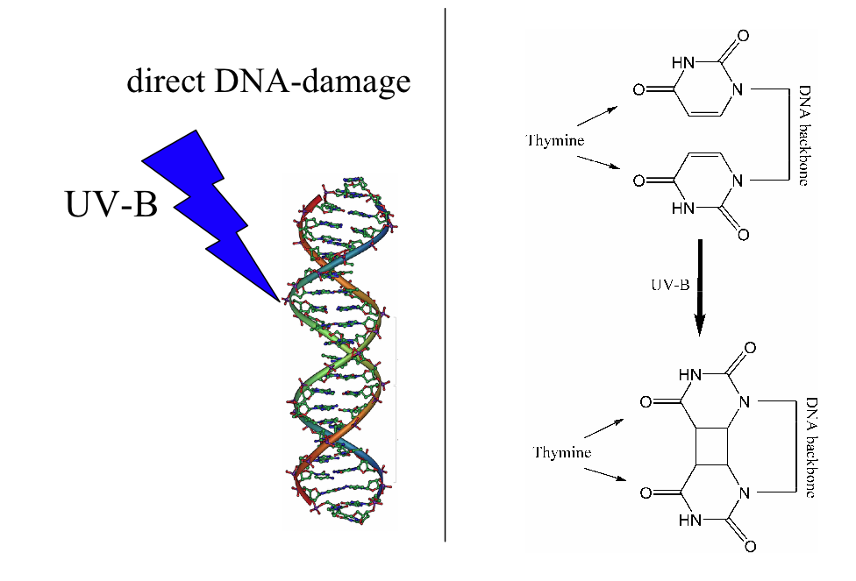
“Sunburn”
Caused by the small amount of UVB that reaches us at ground level

Slide 36
“Sunburn”
There are biological processes that repair this, but if not fixed can lead to mutations.
While not causing sunburn, UVA is also somewhat damaging to the skin contributing to long-term effects such as premature skin aging and skin cancer
Modern sunscreens also block UVA, hence “broad spectrum” because they block UVA and UVB.

Slide 37
Light Matter Interactions - UV
Some important cases related to life, health, and sustainability
interaction with oxygen
interaction with ozone
vitamin D production
sunburn, DNA damage
melanin production
sunscreens

Slide 38
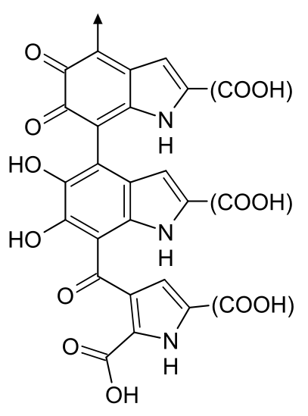
Melanin
Melanin is a polymeric biomaterial that absorbs UV energy striking our skin. It is our natural form of UV protection. Higher amounts of melanin give a darker skin tone
Extra melanin is produced in response to UV radiation
What happens to the energy from the UV radiation?
Eumelanin
It gets converted to heat

Slide 39
Light Matter Interactions - UV
100-280
280-315
315-400
wavelength
Shorter wavelength = higher energy (e.g. energy of UVB > UVA)
Generally higher energy -> greater damage
https://www.compoundsemiconductor.net/article/91348-building-brighter-and-cheaper-uv-leds.html

Slide 40
Light Matter Interactions - UV
Some important cases related to life, health, and sustainability
interaction with oxygen
interaction with ozone
vitamin D production
sunburn, DNA damage
melanin production
sunscreens

Slide 41
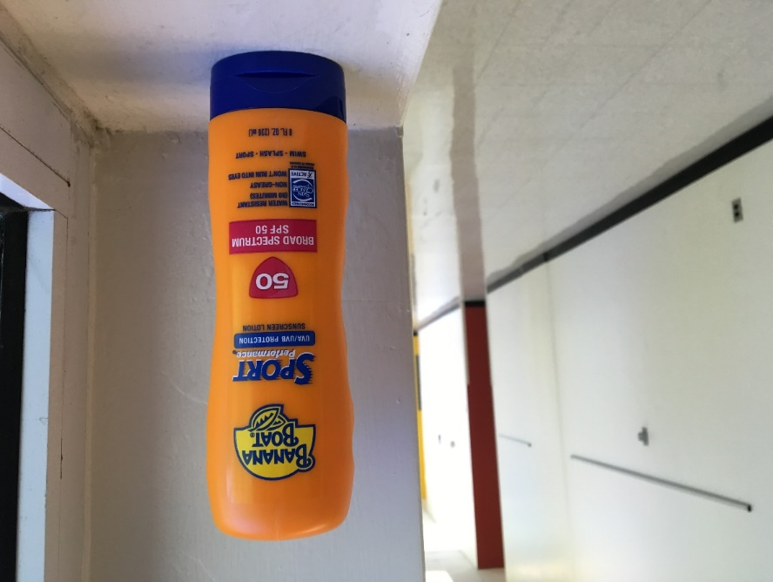
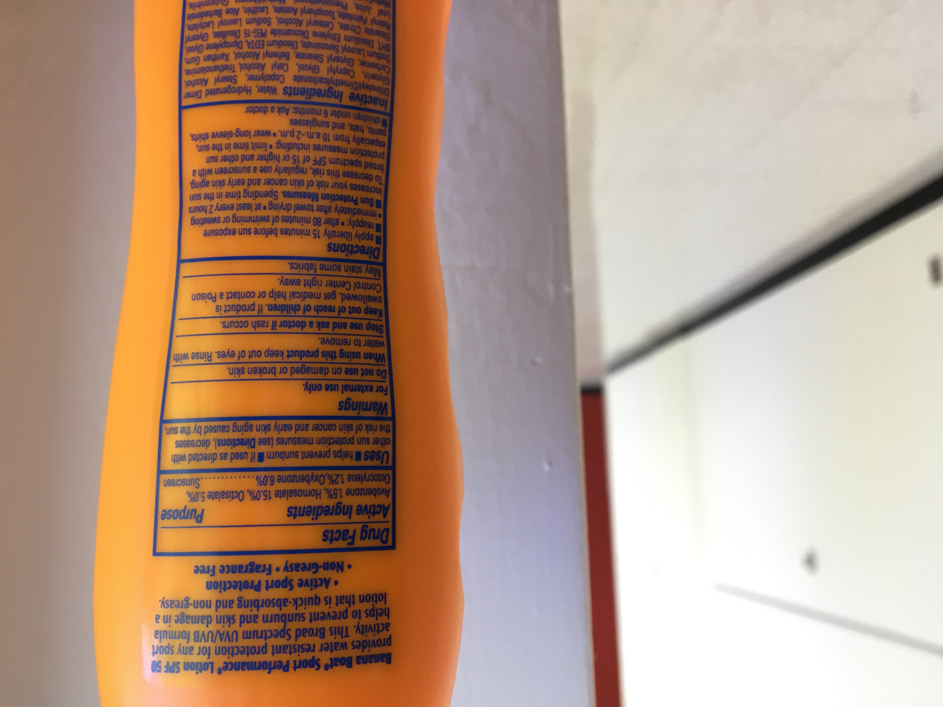
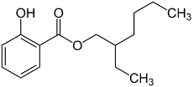
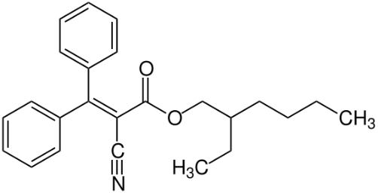
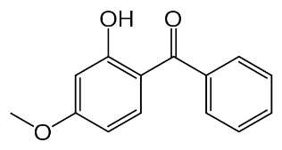
Sunscreen
What’s in it?
avobenzone
homosalate
octisalate
octocrylene
oxybenzone

Slide 42
Sunscreen
What’s in it?
oxybenzone
Avobenzone
(310-400 nm)
(290-360 nm)
octocrylene
homosalate
octisalate
(290-350 nm)
(295-315 nm)
(295-315 nm)
What are some common features?
Why does avobenzone absorb better in the UVA?
http://www.smartskincare.com/skinprotection/sunblocks/sunblock_benzophenones-3-and-4.html

Slide 43
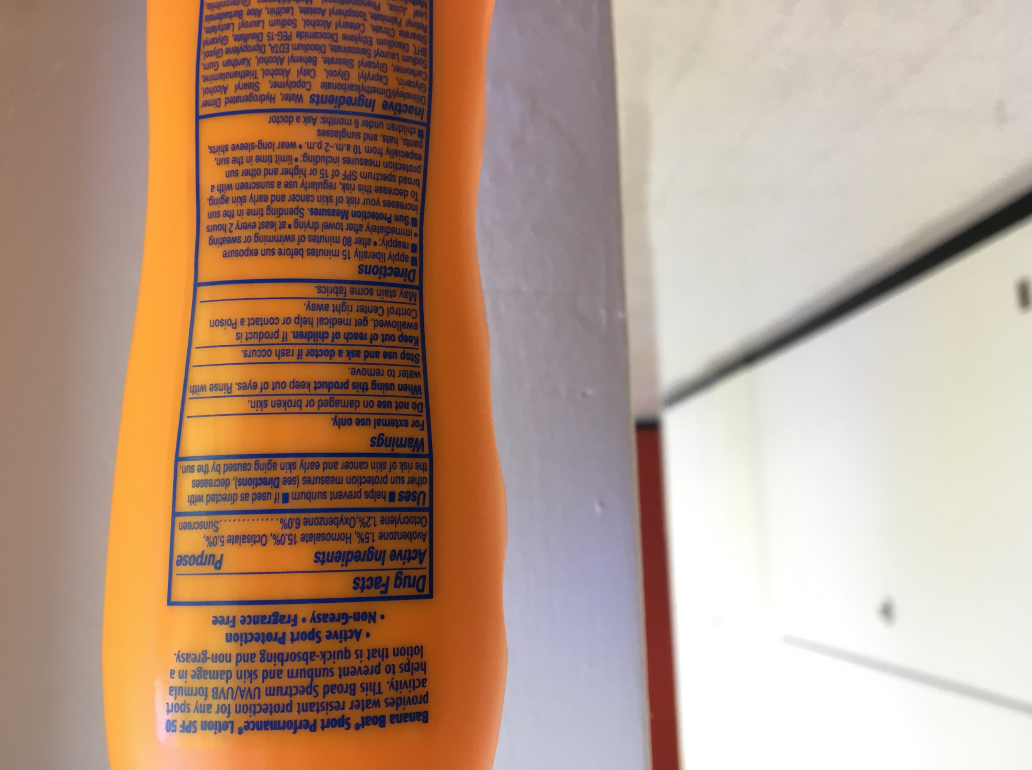
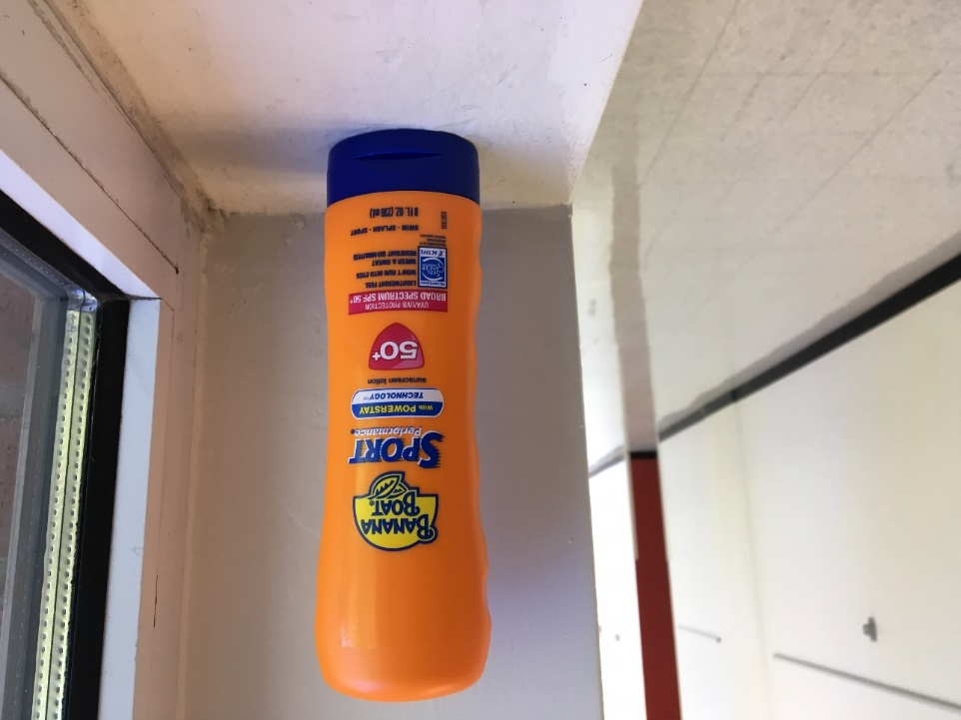
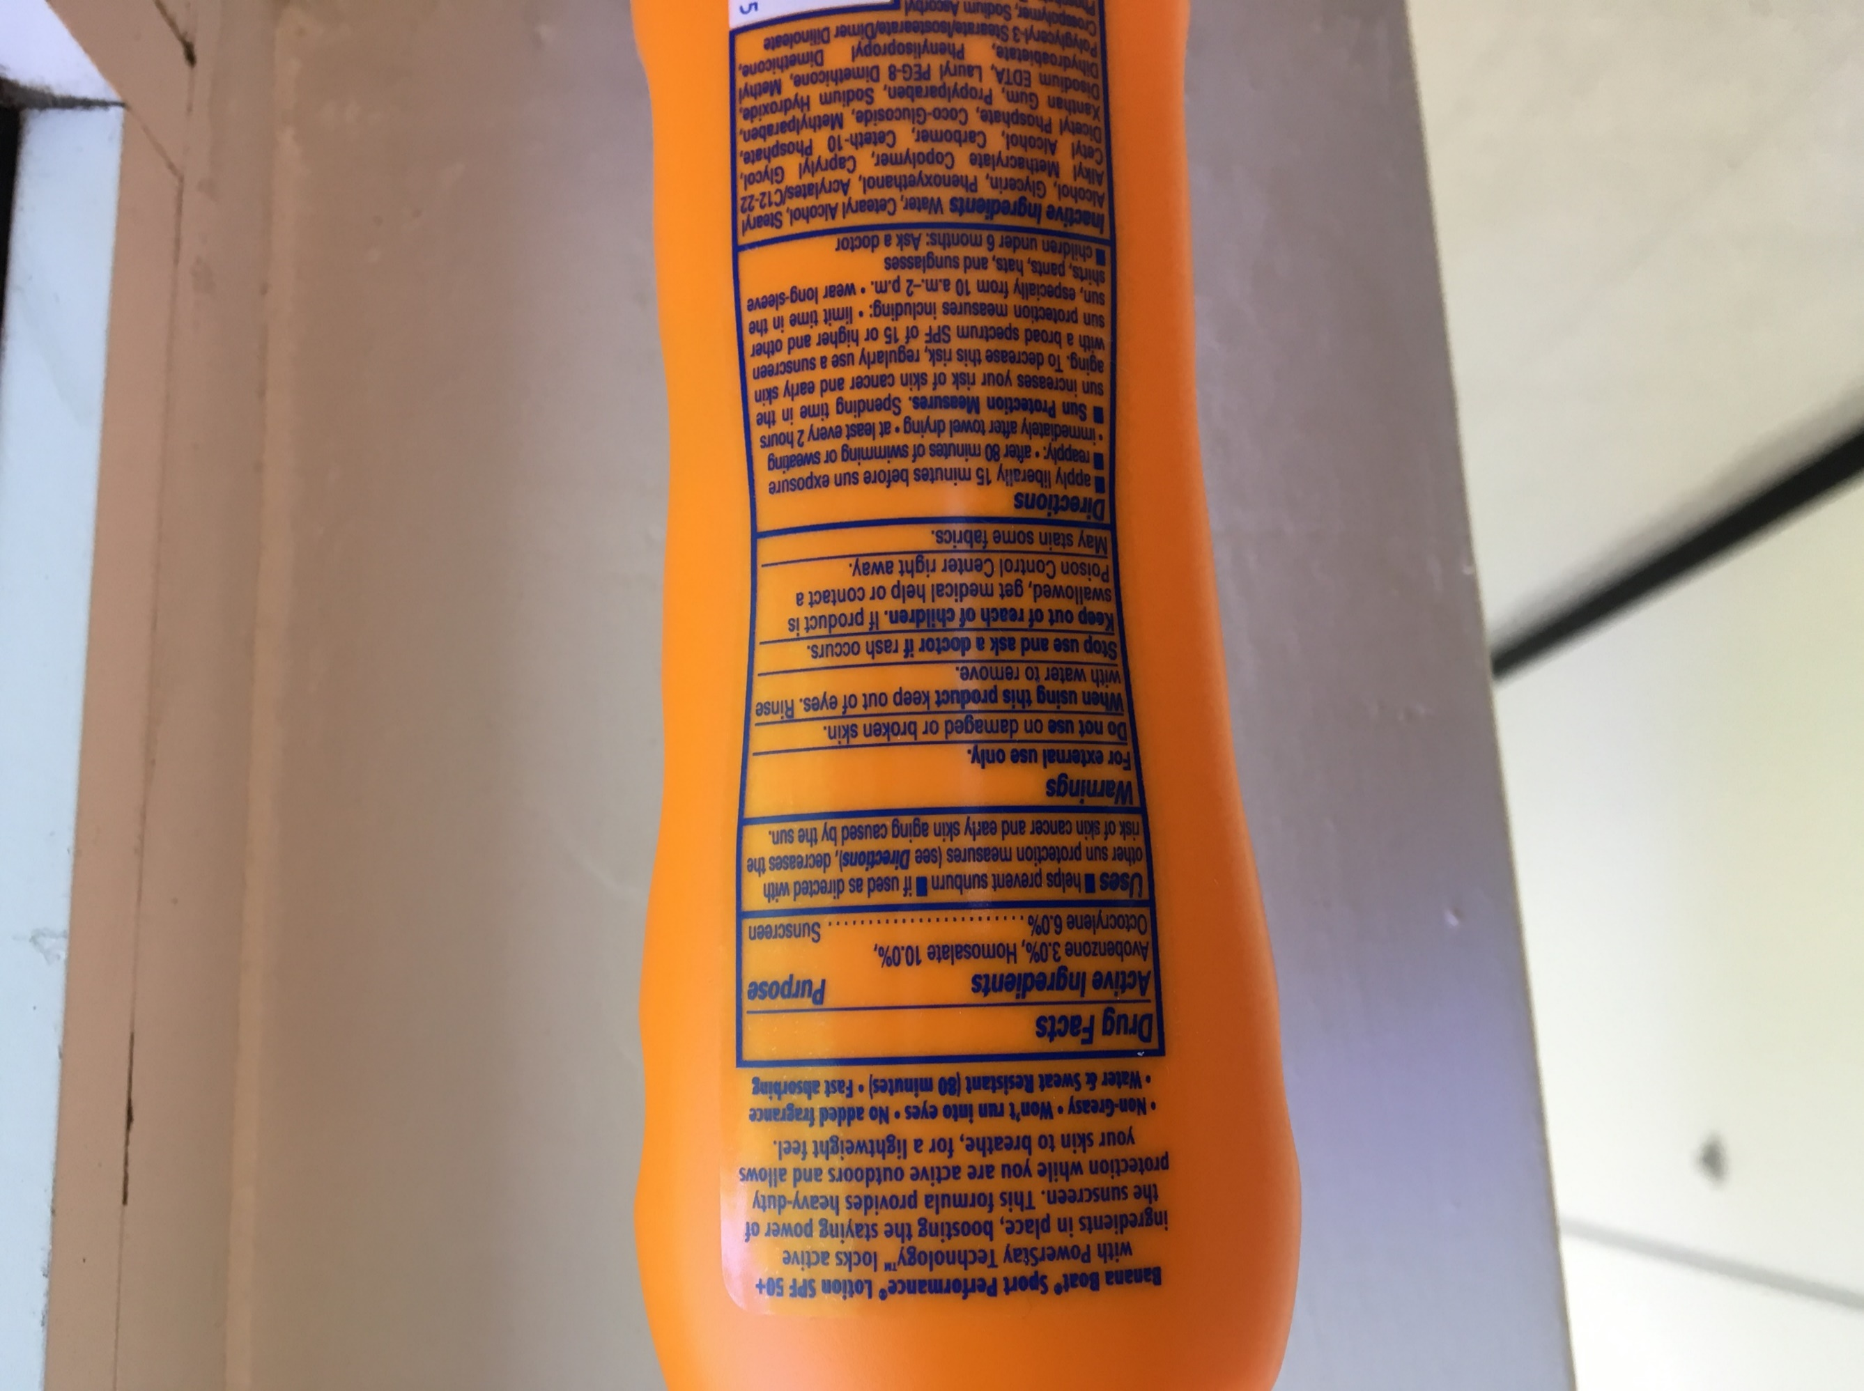
Sunscreen
more recent
What’s in it?
octocrylene needed as photo-stabilizer for avobenzone
~2012
Some controversy associated
with oxybenzone

Slide 44
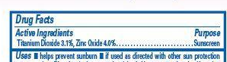
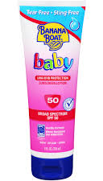
Sunscreen
What’s in it?
TiO₂ (290-350 nm)
ZnO (290-400 nm)
Broadest range of any single sunscreen ingredient
Sometimes called “physical” blockers (vs “chemical”)
These work by absorbing/reflecting/scattering UV light
http://www.smartskincare.com/skinprotection/sunblocks/sunblock_benzophenones-3-and-4.html

Slide 45
Solar Energy

