Slide 1
These slides contain animations, when the PowerPoint file is played
The content gradually appears with clicks
Questions appear before their answers

Slide 2
Green Chemistry and Living in the Desert
Sun
What we do and don’t want from it
Energy from the sun (fossil fuels vs renewables)
Light/matter interactions
Infrared, heat, greenhouse effect
Ultraviolet, sunburn, sunscreen, oxygen, ozone layer

Slide 3
Green Chemistry and Living in the Desert
Sun
What do we want from the sun?
Light to see
Light for plants to grow
Energy to power things
Warmth (in winter)
What don’t we want from it?
Sun damage
Sun burn
Too much heat (summer)
Sun in eyes while driving?
These processes result from the different ways that sunlight interacts with matter

Slide 4
Green Chemistry and Living in the Desert
Sun
Did you know?/have you noticed:
You can sit in the sun behind a window and feel just as hot as if the window was not there, yet not get sunburned
On a somewhat cloudy day you can feel relief from the heat of the sun, yet you can still easily be sunburned
What is going on in those situations?

Slide 5
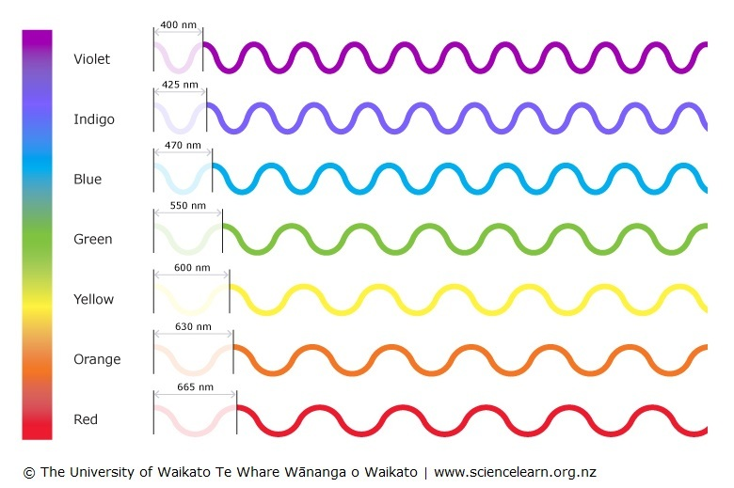
Light Matter Interactions
Considering light as a wave, we can classify light by its wavelength:
higher
energy
But this is just what we can see!

Slide 6
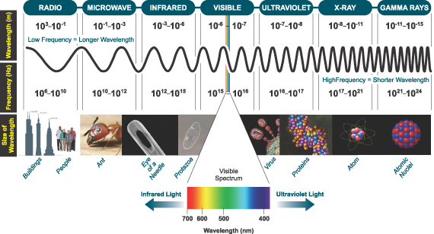
Light Matter Interactions
There is a whole range light types at both higher and lower wavelengths:
higher
energy
http://www.astro.virginia.edu/~rsl4v/PSC/light.html

Slide 7
Light Matter Interactions
What effects does each type (wavelength) of light have on matter?:
X-rays b) Ultraviolet radiation
c) Visible light d) Infra red light
e) Microwaves f) Radiowaves
http://www.astro.virginia.edu/~rsl4v/PSC/light.html

Slide 8
Light Matter Interactions
X-rays
b) Ultraviolet radiation
Visible light
d) Infrared light
Microwaves
f) Radiowaves
Promotion of electrons from low-lying atomic orbitals
Promotion of electrons from molecular orbitals to higher energy molecular orbitals
Same as UV
Excites bond vibrations in molecules
Excite rotations in molecules
Excite nuclear spins in atoms
http://www.astro.virginia.edu/~rsl4v/PSC/light.html

Slide 9
Light Matter Interactions
When we heat matter the atoms and molecules vibrate faster
IR light absorption causes atoms to vibrate within molecules
As a consequence, absorbing IR light causes heating
When we feel heat from the sun’s rays, we are feeling the IR radiation
Importantly, it is the ultraviolet radiation that causes skin damage and sunburn, not the heat from the sun (IR)

Slide 10
Light Matter Interactions
Feeling hot from the sun and getting sunburned have different causes
The earlier examples highlight this:
You can sit in the sun behind a window and feel just as hot as if the window was not there, yet not get sunburned
Glass absorbs the UV radiation that causes sunburn yet allows longer wavelengths (visible and some IR wavelengths) to pass. So, we still feel plenty hot due to the IR radiation.
On a somewhat cloudy day you can feel relief from the heat of the sun, yet you can still easily be sunburned
Clouds (water) absorb and scatter IR radiation more effectively than they do UV. So, we may feel cooler because less IR is striking us, however the penetrating UV can still easily cause sunburn.

Slide 11
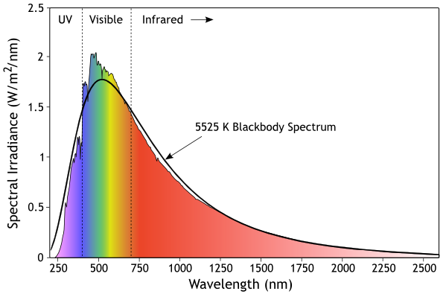
Light from the Sun
Sunlight energy reaching the earth’s surface:
3-5% Ultraviolet
42-43% Visible
52-55% Infrared
Wikipedia – “Sunlight”

Slide 12
Light Matter Interactions
You have probably heard of IR imaging:
Absorbing IR light causes heating
Similarly, in the reverse process warm objects emit IR radiation
Hotter objects emit more IR energy than colder ones

Slide 13
Light Matter Interactions
X-rays
b) Ultraviolet radiation
Visible light
d) Infrared light
Microwaves
f) Radiowaves
Promotion of electrons from low-lying atomic orbitals
Promotion of electrons from molecular orbitals to higher energy molecular orbitals
Same as UV
Excites bond vibrations in molecules
Excites bond rotations in molecules
Excites nuclear spins in atoms

Slide 14
IR Absorption
The energy of the IR light absorbed corresponds to the stretching and
bending of chemical bonds
Stretching
Just as if the bond between the atoms acts like a spring:
The frequency of IR radiation is in the same range as the rate of oscillation of the “spring”
It’s a little more complicated for molecules with more than 2 atoms

Slide 15
Light Matter Interactions
Water and carbon dioxide molecules provide good examples for what happens when IR light is absorbed
Water
Carbon Dioxide
Why are these particular compound’s interactions with IR radiation very important?
The Greenhouse Effect
https://link.springer.com/chapter/10.1007/978-3-031-08834-6_4

Slide 16
Global Warming
How are the ideas of the greenhouse effect, global warming, and climate change related?
Related to pollution, what do we usually hear about as being the “cause” of this problem?

Slide 17
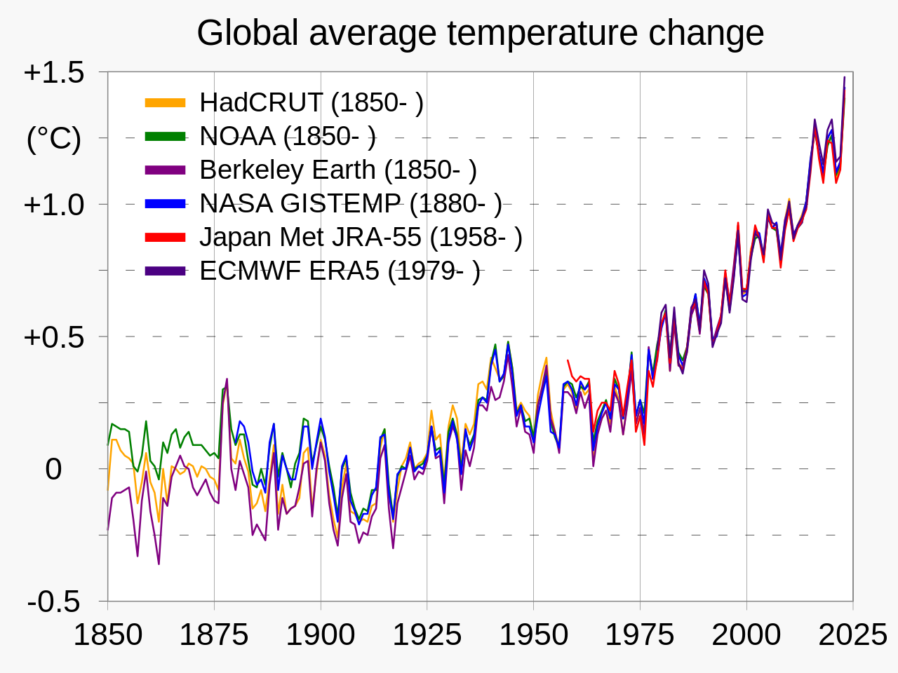
Global Warming
Wikipedia – “Scientific consensus on climate change”

Slide 18
Global Warming
Everybody knows!
In 1917 Alexander Graham Bell wrote "[The unchecked burning of fossil fuels] would have a sort of greenhouse effect", and "The net result is the greenhouse becomes a sort of hot-house."[
- Wikipedia

Slide 19
Green House Effect
What is it?
When heat energy is radiated from the earth’s surface, molecules in the atmosphere absorb some of that radiation, effectively leading to a retention of the heat

Slide 20
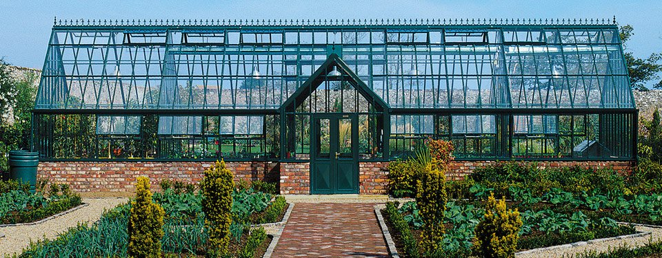
Green House Effect
A real greenhouse works because the air that is heated inside is trapped by the structure.

Slide 21
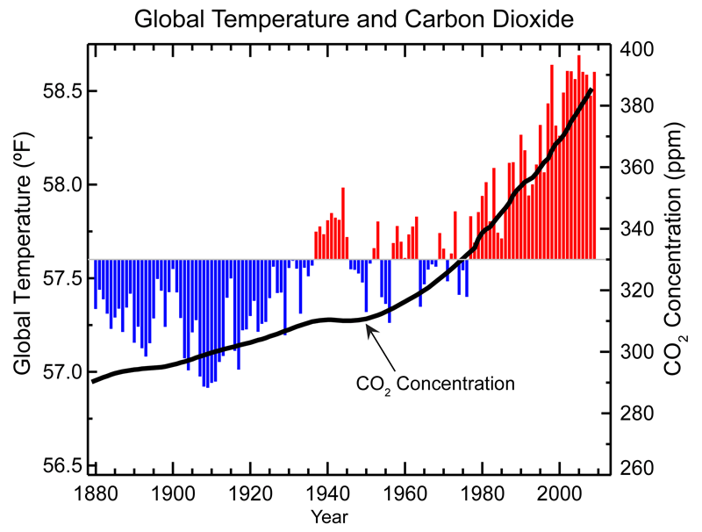
Carbon Dioxide
What does this graph tell us?
Pretty compelling that with more CO₂ the temperature is higher!

Slide 22
Atmosphere Composition
We know that CO₂ is the gas that everyone talks about when discussing global warming. But how much of it is there in the air?
What is the air made of?
N₂ 78%
O₂ 21%
Ar 1%
H₂O ~1% (varies)
So, where’s the CO₂?

Slide 23
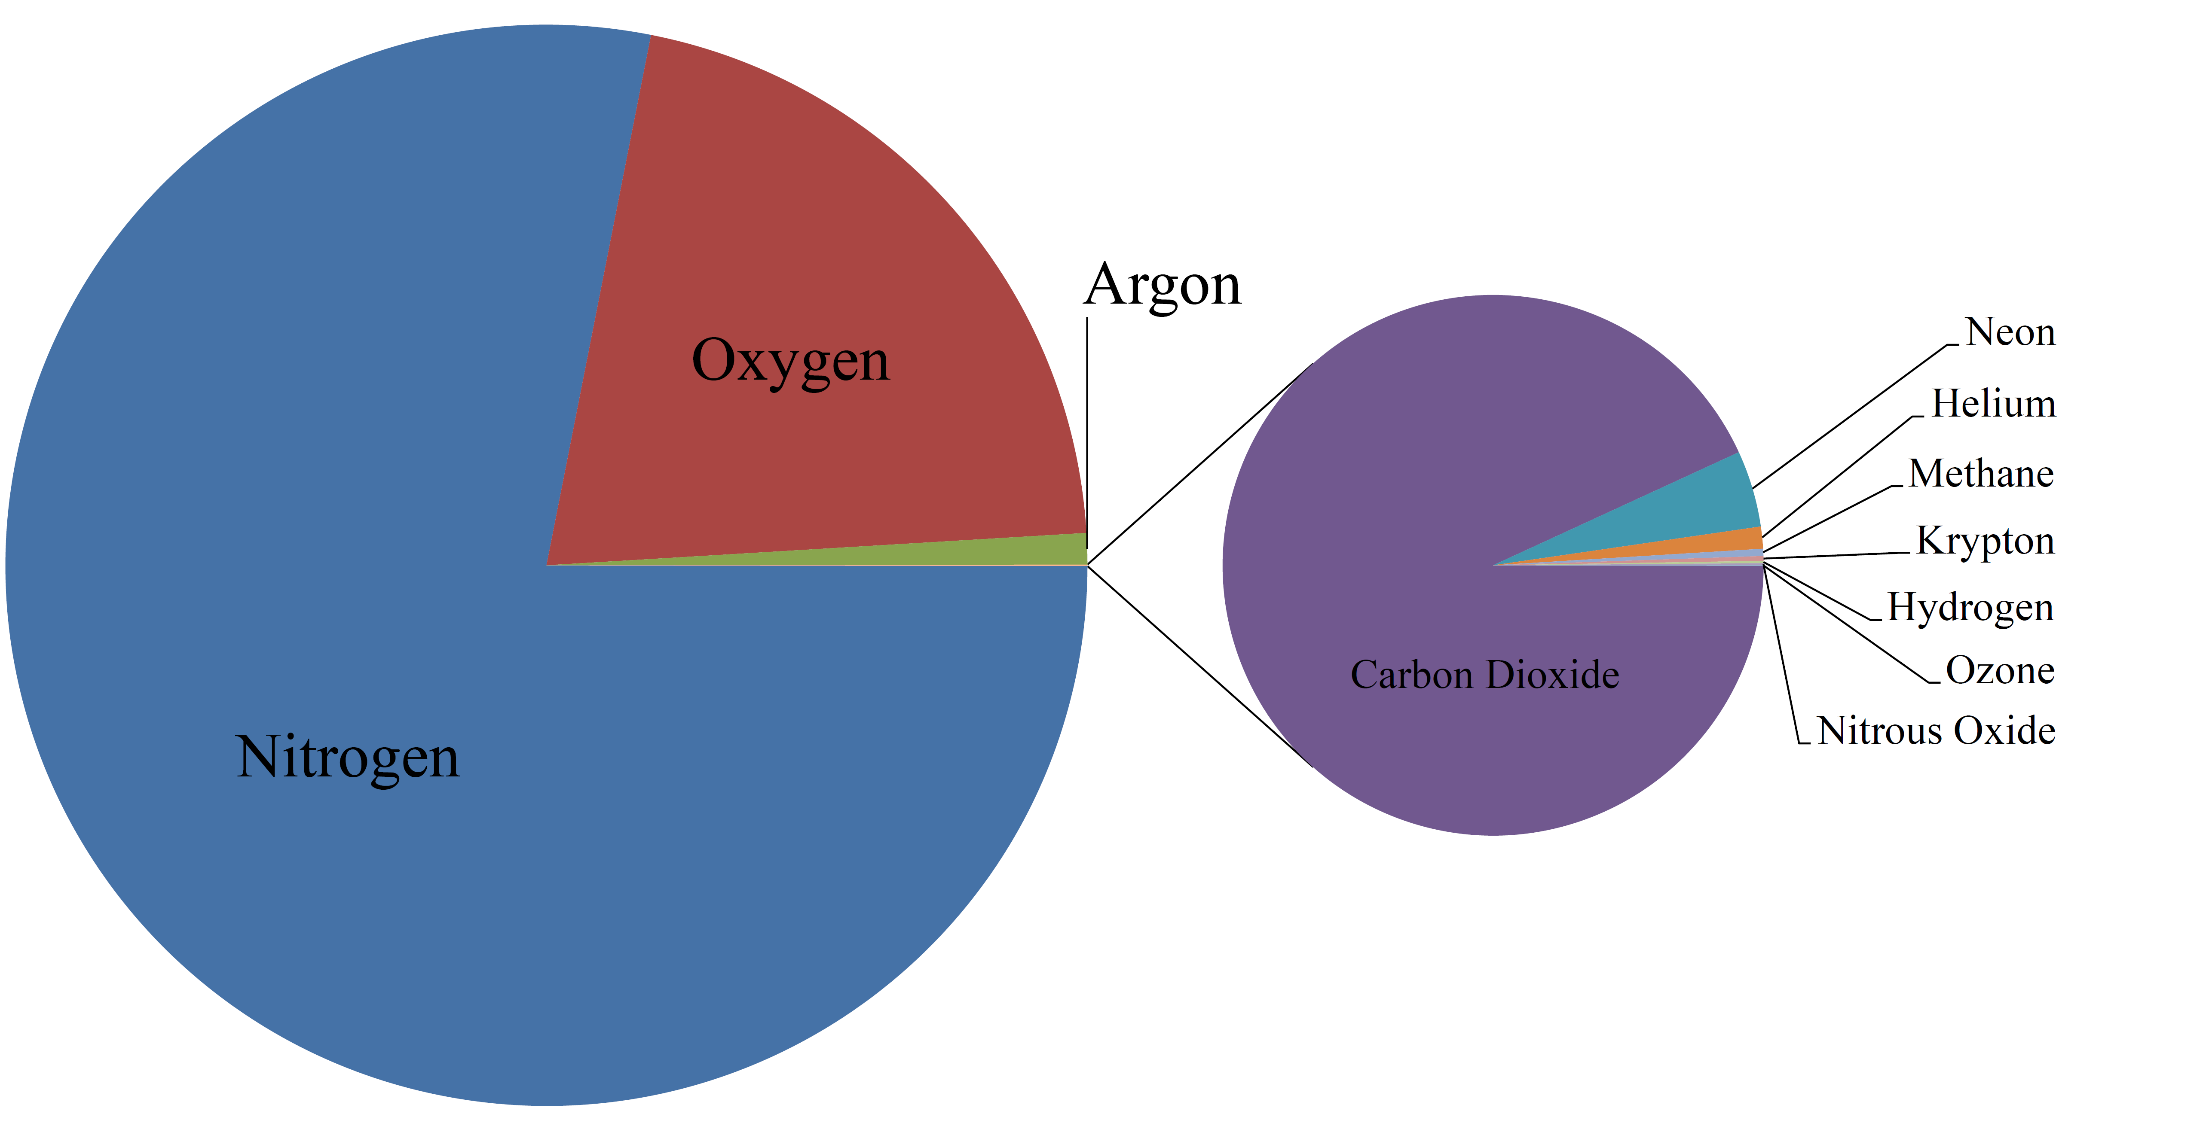
Atmosphere Composition
There’s not much CO₂ in the air (about 0.04%), but that amount has a large effect
Importantly, the atmosphere’s two major gases N₂ and O₂ do not absorb IR radiation.

Slide 24
Green House Effect
The earth’s average surface temperature is about 14 °C (57 °F)
What would you expect the earth’s surface temperature to be under the following circumstances?:
No atmosphere
100% oxygen atmosphere
Air with 5% CO₂ atmosphere
100% CO₂ atmosphere

Slide 25
Green House Gases
The major contributor to the green house effect on earth is actually water
Percentage contribution (the major contributors) to the greenhouse effect:
Water vapor 36-70%
Carbon dioxide 9-26%
Methane 4-9%
Ozone 3-7%
~ 1.000000%
~ 0.042000%
~ 0.000170%
~ 0.000007%
But what are the percentages of these in the air?

Slide 26
Green House Gases
Contribution to greenhouse effect
Percentage of the atmosphere
~ 1.000000%
Water vapor 36-70%
Carbon dioxide 9-26%
Methane 4-9%
Ozone 3-7%
~ 0.037000%
~ 0.000170%
~ 0.000007%
Clearly, the gases do not influence the greenhouse effect with the same efficiency
Another factor that must be considered is how long the gases persist in the atmosphere
“Global Warming Potential” is a number that factors all of these into consideration.

Slide 27
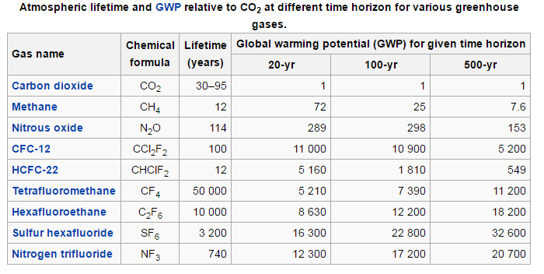
Some Other Greenhouse Gases
https://en.wikipedia.org/wiki/Greenhouse_gas

Slide 28
Carbon Dioxide
Where is all this CO₂ coming from?
The combustion of hydrocarbon fuels:
C_{x}H_{y} + O₂ -> x CO₂ + 2y H₂O + Energy
Where are those from?
Mostly from:
Natural Gas
Petroleum
Coal
The “fossil fuels”

