Slide 1
Green Chemistry

Slide 2
Green Chemistry
Green Chemistry offers a solution to a problem
So, what is that problem?

Slide 3
Green Chemistry
Here are some words that are used to describe products we buy and use:
Chemical, Green, Synthetic, Made, Home-made, Engineered, Chemical-free, Sustainable, Preservative, Recycled, Modified, Pesticide, Natural, Organic
Which do people generally like to hear about their products?

Slide 4
Green Chemistry
What do people generally like to hear about products?
Natural
Chemical
Organic
Green
Sustainable
Home-made
Chemical-free
Recycled
Synthetic
Engineered
Modified
Made
Preservative
Pesticide
For many “chemical” and related terminology is negative
But why?

Slide 5
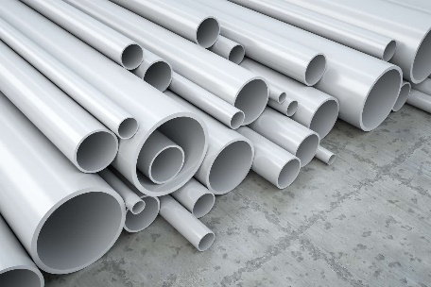
Green Chemistry
Here’s a reason:
What’s this stuff?
PVC pipe
PVC = polyvinyl chloride
Made from vinyl chloride
To have PVC we occasionally have to deal with incidents like…..
The 2023 Ohio Train Derailment

Slide 6
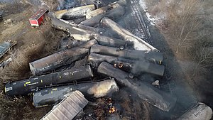
Green Chemistry
The 2023 Ohio Train Derailment:
East Palestine, Ohio
49 cars in derailment pile, which caught fire and burned for days
11 were tank cars, which dumped 100,000 gallons of hazardous materials, including vinyl chloride, benzene residue, and butyl acrylate.

Slide 7
Green Chemistry
The 2023 Ohio Train Derailment:
To reduce the explosion risk, the vinyl chloride cars were ruptured, drained into a trench, and the material set on fire.
This produced HCl and phosgene
and soot!
All kinds of concerns about soil, water, and air contamination!

Slide 8
Green Chemistry
Have you heard of all of these?
DDT benzene ozone
arsenic carbon dioxide lead
mercury dioxin BPA
PFAS
These are some of the well-recognized chemicals causing environmental concern

Slide 9
Green Chemistry
Advances in chemistry have provided us with many things.
e.g. Related to Transport, Communication, Living, etc.
Let’s pick one area – Transportation
What are chemistry advances that were not available say 50 years ago?

Slide 10
Green Chemistry
Advances in chemistry have provided us with many things.
These have come at some cost, one manifestation is “pollution”
Aside from gradual impacts on the environment, there have been many notable “incidents”
Some US examples:
Cuyahoga river ~1870-1970 (caught fire (13 times!))
Love canal ~1970 (various chemicals)
Times beach ~1983 (dioxin contamination)

Slide 11
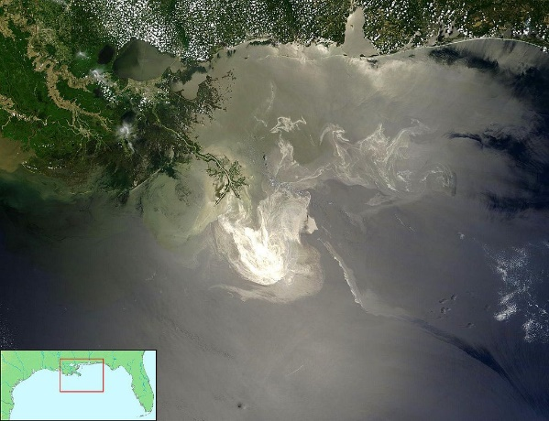
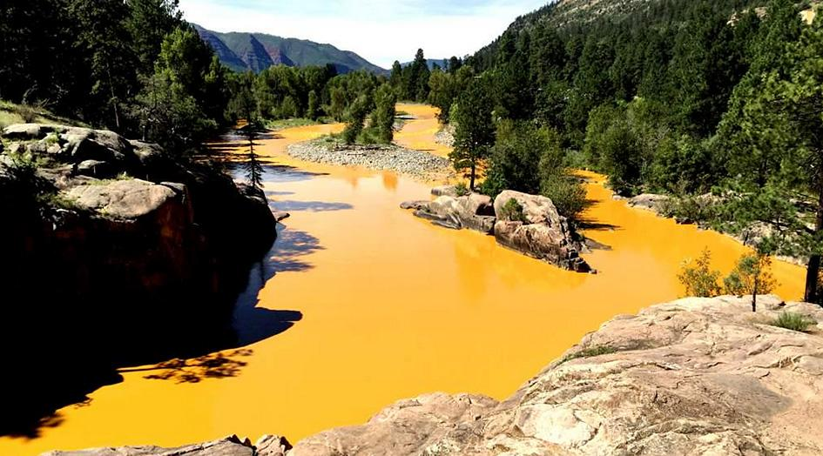
Green Chemistry
Some More Recent Big Incidents
Deepwater Horizon oil spill, April 2011
210 million gallons released
Cement creek Colorado 2015
3 million gallons of mine (Gold King mine) waste into river
Arsenic, cadmium, lead, mercury, (aluminum, copper)

Slide 12
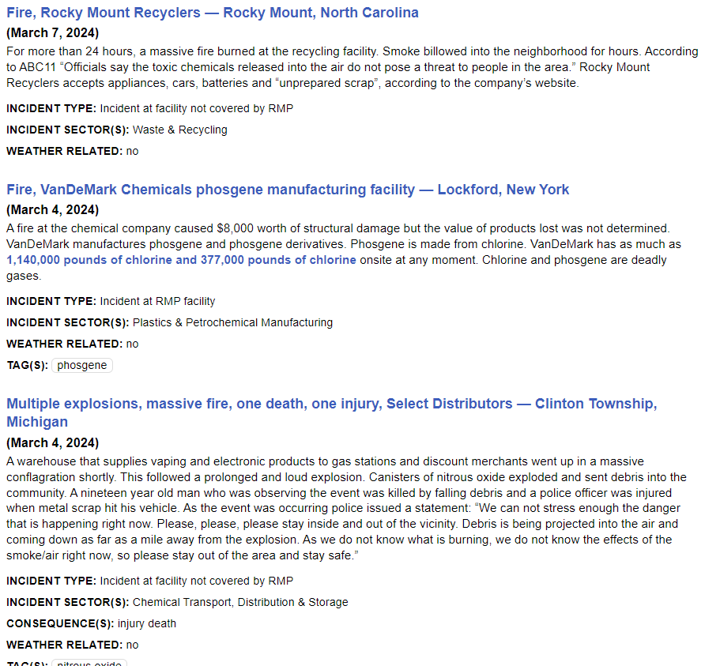
Green Chemistry
Actually - There’s some kind of notable chemical incident in the US about every other day!
Coalition to Prevent Chemical Disasters: https://preventchemicaldisasters.org/chemical-incident-tracker/overview

Slide 13
Green Chemistry
Each big incident leads to a public response and then a government response. As a result, the following policies have been developed:
Clear Air Act
The Resource Recovery and Conservation Act
The Safe Drinking Water Act
Superfund in the USA
So, there has been a gradual evolution since about 1945 until now that has better regulated our dispensing of chemicals into the environment.

Slide 14
Green Chemistry
Chemists may have created problems, but they are also the ones to solve them!
For example – gasoline powered cars
Emissions Problems Solved:
alternative anti-knock additives have been employed
Lead –
SO_{x} –
most sulfur is now removed from gasoline before use
NO_{x} –
catalytic converter - N leaves as N₂
CO -
catalytic converter - C leaves as CO₂
Volatile hydrocarbons -
catalytic converter
Now just down to the inescapable problems of CO₂ production and fossil fuel depletion

Slide 15
Green Chemistry
How do we deal with chemical hazards?
What are some types of chemical hazards?
Explosive, lachrymator, vesicant, pyrophoric, carcinogen, teratogen, sternutator, caustic, corrosive, oxidizer, irritant, sensitizer.
Hazards
Poison is in everything, and no thing is without poison. The dosage makes it either a poison or a remedy.
Paracelsus – a renowned alchemist of the 16th century
Really? What about air? What about water? Are those poisons?

Slide 16
Green Chemistry
Air
Quick Q – What are the major components air?
78% nitrogen (N₂), 21% oxygen (O₂), ~1% argon (Ar), ~1% H₂O
Anyone been scuba diving?
Breathing air at increased pressure causes humans to experience “nitrogen narcosis” - similar effect to alcohol.
Oxygen becomes toxic above a certain pressure, when diving deep enough oxygen toxicity is also a problem.

Slide 17
Green Chemistry
Water
Hyponatremia (low sodium concentration in the blood)

Slide 18
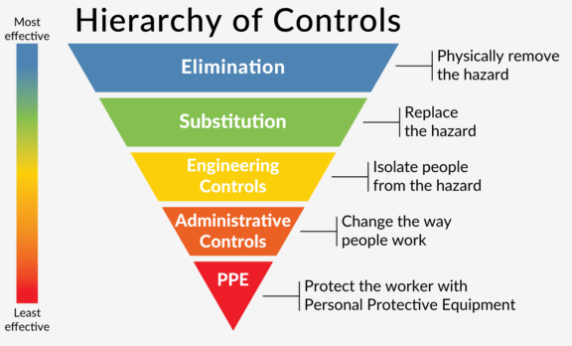
Green Chemistry
Anastas and Warner provide the following formula:
Risk = f[hazard,exposure]
One strategy is that if we can reduce or eliminate exposure we can reduce or eliminate risk
From there we can consider ideas of exposure controls

Slide 19
Green Chemistry
Which control method is most effective?
https://makesafetools.com/osha-hierarchy-of-controls/

Slide 20
Green Chemistry
Problems with “exposure controls” (= “end of pipe” controls)
Uncertainties exist with all of the following:
Risks are not known for many (most?) substances
Synergistic effects
Chronic effects
Bioaccumulation
and what if the exposure controls fail?

Slide 21
Green Chemistry
Green Chemistry aims to address chemical hazard problems here
No hazard = no risk
(Risk = f[hazard,exposure])

Slide 22
Green Chemistry
Exposure Controls
Amounts to reducing risks to an acceptable level
Acceptable to whom?
Green Chemistry minimizes hazards by not using hazardous materials or generating hazardous products in the first place!

Slide 23
Green Chemistry
“Green chemistry is the design of chemical products and processes that reduce or eliminate the use or generation of hazardous substances. Green chemistry applies across the life cycle of a chemical product, including its design, manufacture, use, and ultimate disposal. Green chemistry is also known as sustainable chemistry.”
- Environmental Protection Agency (EPA)
https://www.epa.gov/greenchemistry/basics-green-chemistry#definition

Slide 24
Green Chemistry
Green Chemistry vs Cleaning up Pollution?
Cleaning up pollution (also called remediation) involves treating waste streams (end-of-the-pipe treatment) or cleanup of environmental spills and other releases
Removes hazardous materials from the environment
Green Chemistry reduces pollution at its source by minimizing or eliminating the hazards of chemical feedstocks, reagents, solvents, and products
Keeps hazardous materials out of the environment
in the first place
https://www.epa.gov/greenchemistry/basics-green-chemistry#definition

Slide 25
12 Principles of Green Chemistry
Prevent Waste
Maximize Atom Economy
Design Less Hazardous Chemical Syntheses
Design Safer Chemicals and Products
Use Safer Solvents and Reaction Conditions
Increase Energy Efficiency
Use Renewable Feedstocks
Avoid Chemical Derivatives
Use Catalysts, not Stoichiometric Reagents
Design Chemicals and Products to Degrade after Use
Analyze in Real-time to Prevent Pollution
Minimize the Potential for Accidents
https://www.epa.gov/greenchemistry/basics-green-chemistry#definition

Slide 26
Green Chemistry
Using Green Chemistry has broad benefits
If, for example, a company adopts a green chemistry process they will see benefits beyond just reducing environmental impact from their process:
Lowered costs –
Fewer hazardous shipping costs
Reduced waste disposal costs
Reduced infrastructure costs (more hazards = more expensive equipment to deal with them)
Less time used managing safety/hazards
etc.

Slide 27
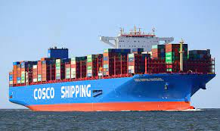
Green Chemistry - Examples
1996 Green Chemistry Challenge Award Winner -
Dow Chemical Company – Designing an Environmentally Safe Marine Antifoulant
We are talking about ships – e.g cargo ships
What is fouling?
Unwanted growth of plants and animals on the ships hull
What’s the problem?
Increased drag through the water
Use a chemical agent to kill the fouling organisms

Slide 28
Green Chemistry - Examples
1996 Green Chemistry Challenge Award Winner -
Dow Chemical Company – Designing an Environmentally Safe Marine Antifoulant
TBTO was heavily used. It was incorporated in the paint on the hull.
Slowly leached out killing the fouling organisms
Long half-life in the environment (~6 months)
Bioconcentrates in marine organisms (chronically toxic)
Tributyltin oxide (TBTO)

Slide 29
Green Chemistry - Examples
1996 Green Chemistry Challenge Award Winner -
Dow Chemical Company – Designing an Environmentally Safe Marine Antifoulant
Dow developed “Sea-Nine 211”
Low water solubility
No bioaccumulation in the food chain
Not persistent (half-life <1 h)
Competitive price/performance
4,5-dichloro-2-n-octyl-4-isothiazolin-3-one (DCOI)
TBTO banned worldwide by the International Marine Organization, phased out by 2008

Slide 30
Green Chemistry - Examples
The Green Chemistry Challenge Awards promote the environmental and economic benefits of developing and using novel green chemistry.
Sponsored
by the Environmental Protection Agency (EPA)
Partners
American Chemical Society (ACS) Green Chemistry Institute
Industrial
Trade Associations
Academic Institutions
other Government Agencies

Slide 31
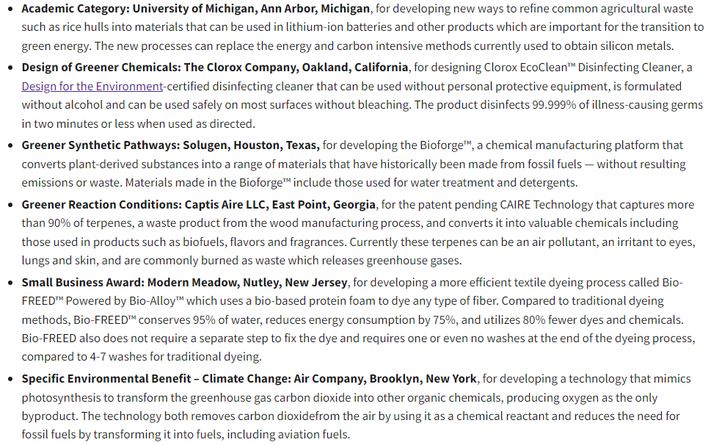
Green Chemistry Challenge
2023 Award Winners
https://www.epa.gov/greenchemistry/green-chemistry-challenge-winners

Slide 32
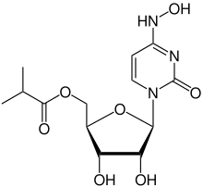
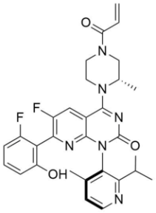
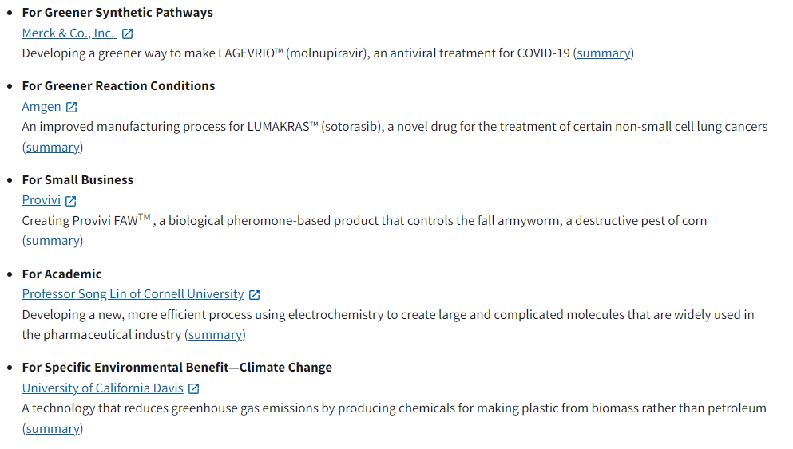
Green Chemistry Challenge
https://www.epa.gov/greenchemistry/green-chemistry-challenge-winners

Slide 33
Example - Greener Oxidation Procedure – U of A
Old Procedure:
Current Procedure:
What makes the newer procedure greener?
1. Reactant/reagent/solvent safety?
- for people doing the experiment
- to the environment
2. Waste
- what is the waste?
- how does it need to be disposed of?

Slide 34
Greener Oxidation Procedure – U of A
Old Procedure:
Other products:
Unreacted Cr(VI) – highly toxic, carcinogenic, major
environmental hazard
Cr(III) - environmental hazard
H₂SO₄ - highly corrosive
Ether - volatile, flammable
Water
New Procedure:
Other products (after NaHSO₃ addition):
Na⁺
K⁺
HSO₄⁻
SO₄²⁻
Cl⁻
Ethyl acetate - flammable
Water

Slide 35
Greener Oxidation Procedure – U of A
Old Procedure:
Prevent Waste
Maximize Atom Economy
Design Less Hazardous Chemical Syntheses
Design Safer Chemicals and Products
Use Safer Solvents and Reaction Conditions
Increase Energy Efficiency
Use Renewable Feedstocks
Avoid Chemical Derivatives
Use Catalysts, not Stoichiometric Reagents
Design Chemicals and Products to Degrade after Use
Analyze in Real-time to Prevent Pollution
Minimize the Potential for Accidents
Current Procedure:
Which of the 12 principles of green chemistry are incorporated in this example?

Slide 36
Greener Oxidation Procedure – U of A
Old Procedure:
Current Procedure:
Is the new procedure perfectly green? If not, what types of changes would be needed to make it even greener?

Slide 37
Green Chemistry
Importantly, in practice very few processes are entirely green
Realistically, while that is the goal, a more typical sub-goal is to make processes “greener”
Metrics have been developed to assess the “greenness” of processes e.g. Atom economy, Effective mass efficiency, E factor, EcoScale

Slide 38
Greener Oxidation Procedure – U of A
Old procedure:
Current procedure:
In this oxidation lab experiment example ideally, there would be no solvent (or water as solvent?), oxygen from the air would be used (maybe with a catalyst) as the oxidizing agent, etc.

Slide 39
Green Chemistry
This Page (EPA) contains link to many resources for further information about Green Chemistry
https://www.epa.gov/greenchemistry/green-chemistry-resources#education

